Slide 1


Slide 2
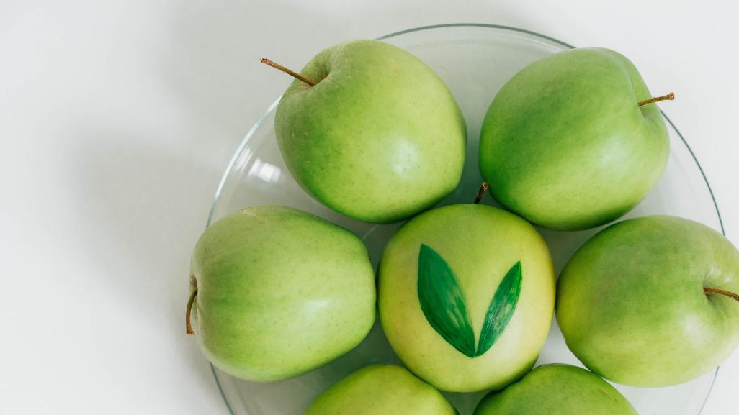

Introductory
NOTES:
1. Message:
The message today is context
  Ie. How does my farm compare to the benchmark given my unique circumstances?
  What is possible?
  Identify focus areas.
Benchmarking is a tool to be used on various measurements – NOT JUST PROFIT PER HECTARE
Production of the right quality and size is King. More focus on quality of fruit on tree.
2. Capital allocation:
How to look at returns over time
The upside of new strains, technologies & planting techniques
3. Standard “pack shed depreciation charge” deducted per ton for all self packers
4. First time attendees – Please read page 7 and find Pin number in the back of the book
5. Individual feedback sessions
6. Tea break & arrangements

Slide 3
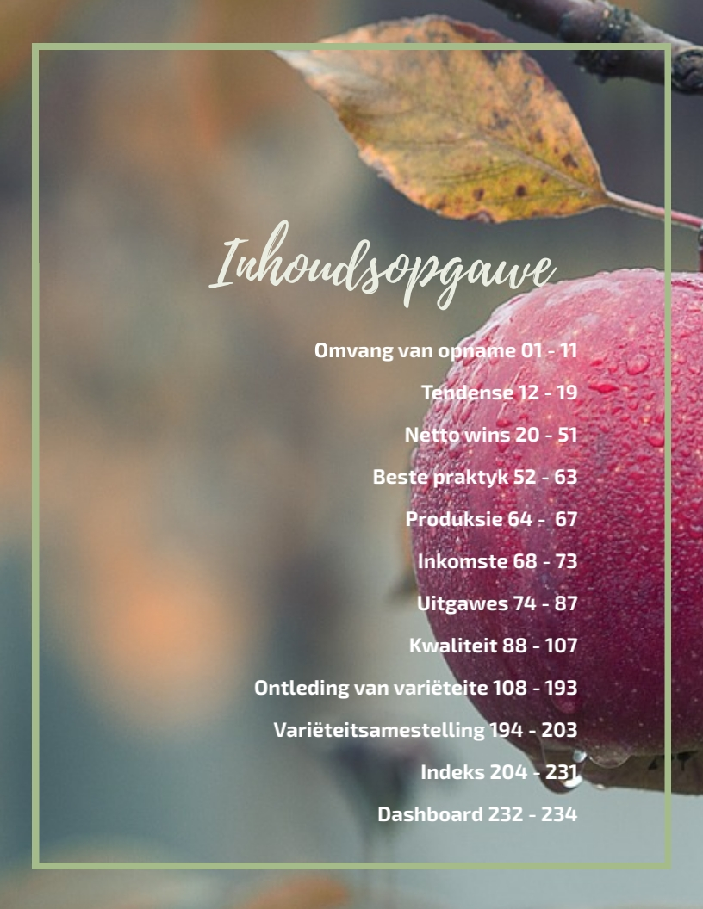

Slide 4

P1.

Slide 5

Koste & Inkomste opname: 2018/2019
 | Deelnemers:
Plaas | Verantwoordelike persoon
(* = Nuwe deelnemers)
Boesmansrug | Ken Kilpin/Phil Kilpin
Boomerang Fruits | James Strachan
Chiltern Farm | Justin Mudge
Clouds End | Brian Frost
De Rust Landgoed | Paul Cluver/Karin Cluver
Dennegeur | Stephan Beukes
Diepgat Plase | Len Hauman
Elgin Orchards | Niel Reid/Hanlie Green
Fruitways | Hannes Halgryn
Glen Fruin | Ross Heyns
Glenbrae | Albert Rust
Habibi Farming | Danie du Plessis
Hoogland | Cobus Nel
Hutton-Squire Farms | Richard Hutton-Squire
Karweyderskraal | Danie van Zyl
Kleine Heidepan Plase | Arno Reuvers
Lebanon Fruit Farm | Pikkie Grobbelaar
Lourens Agri | Kobus Lourens
Lourensford | Cornè Fourie
Monteith | Andries Erwee
Môreson Trust | Pieter de Wet
Nidderdale Farm* | Craig Johnson
Niel Loubser Boerdery | Niel Loubser
Oak Valley | Neville van Vuuren
PP Mong Trust | Bertus Mong
Provider Farming* | Christo de Wet
Remhoogte | Thys Blom
Restanwold | Ian Walton
Strathian Farm | Danie du Plessis
The Valley | Mike du Toit
Vredenhof Farm | Barry van Breda
bdk auditors | Fruit Benchmarking survey 2019 10

Slide 6
Koste & Inkomste opname: 2018/2019
Koste & Inkomste opname 2018/19
Statistieke oor 2018 oesjaar en koste tot 28/02/2019:
 | Nr | Omvang van opname | 2018 | 2017 | 2016
 | 1. | Hektare onder bome | 5,209 ha | 5,474 ha | 5,044 ha
 | 2. | Arbeidskoste | R 398.92 mil | R 386.06 mil | R 337.08 mil
 | 3. | Spuitstowwe en kunsmis | R 143.23 mil | R 140.47 mil | R 134.25 mil
 | 4. | Brandstof & vervoer | R 61.71 mil | R 53.52 mil | R 44.08 mil
 | 5. | Lopende koste voor rente
 |  | en waardevermindering | R 774.64 mil | R 748.25 mil | R 673.87 mil
 | 6. | Ekwivalente krat produksie | 676,618 kratte | 756,436 kratte | 704,526 kratte
 | 7. | Gemiddelde produksie | 58 ton/ha | 62 ton/ha | 65 ton/ha
 | 8. | Inkomste alle variëteite | R 1085.0 mil | R 1017.2 mil | R 996.14 mil
 | 9. | Inkomste alle appels | R 907.77 mil | R 805.13 mil | R 774.47 mil
 | 10. Ha Appels Groenland/Vyeboom |  | 10,301 | 10,270 | 10,209
 | 11. Ha Appels deelnemers |  | 4,272 | 4,431 | 4,040
 | 12. % Verteenwoordig |  | 41% | 43% | 40%
 | 13. Ha Pere Groenland/Vyboom |  | 2,520 | 2,566 | 2,622
 | 14. Ha Pere deelnemers |  | 879 | 955 | 910
 | 15. % Verteenwoordig |  | 35% | 37% | 35%
bdk auditors | Fruit Benchmarking survey 2019 10

Slide 7
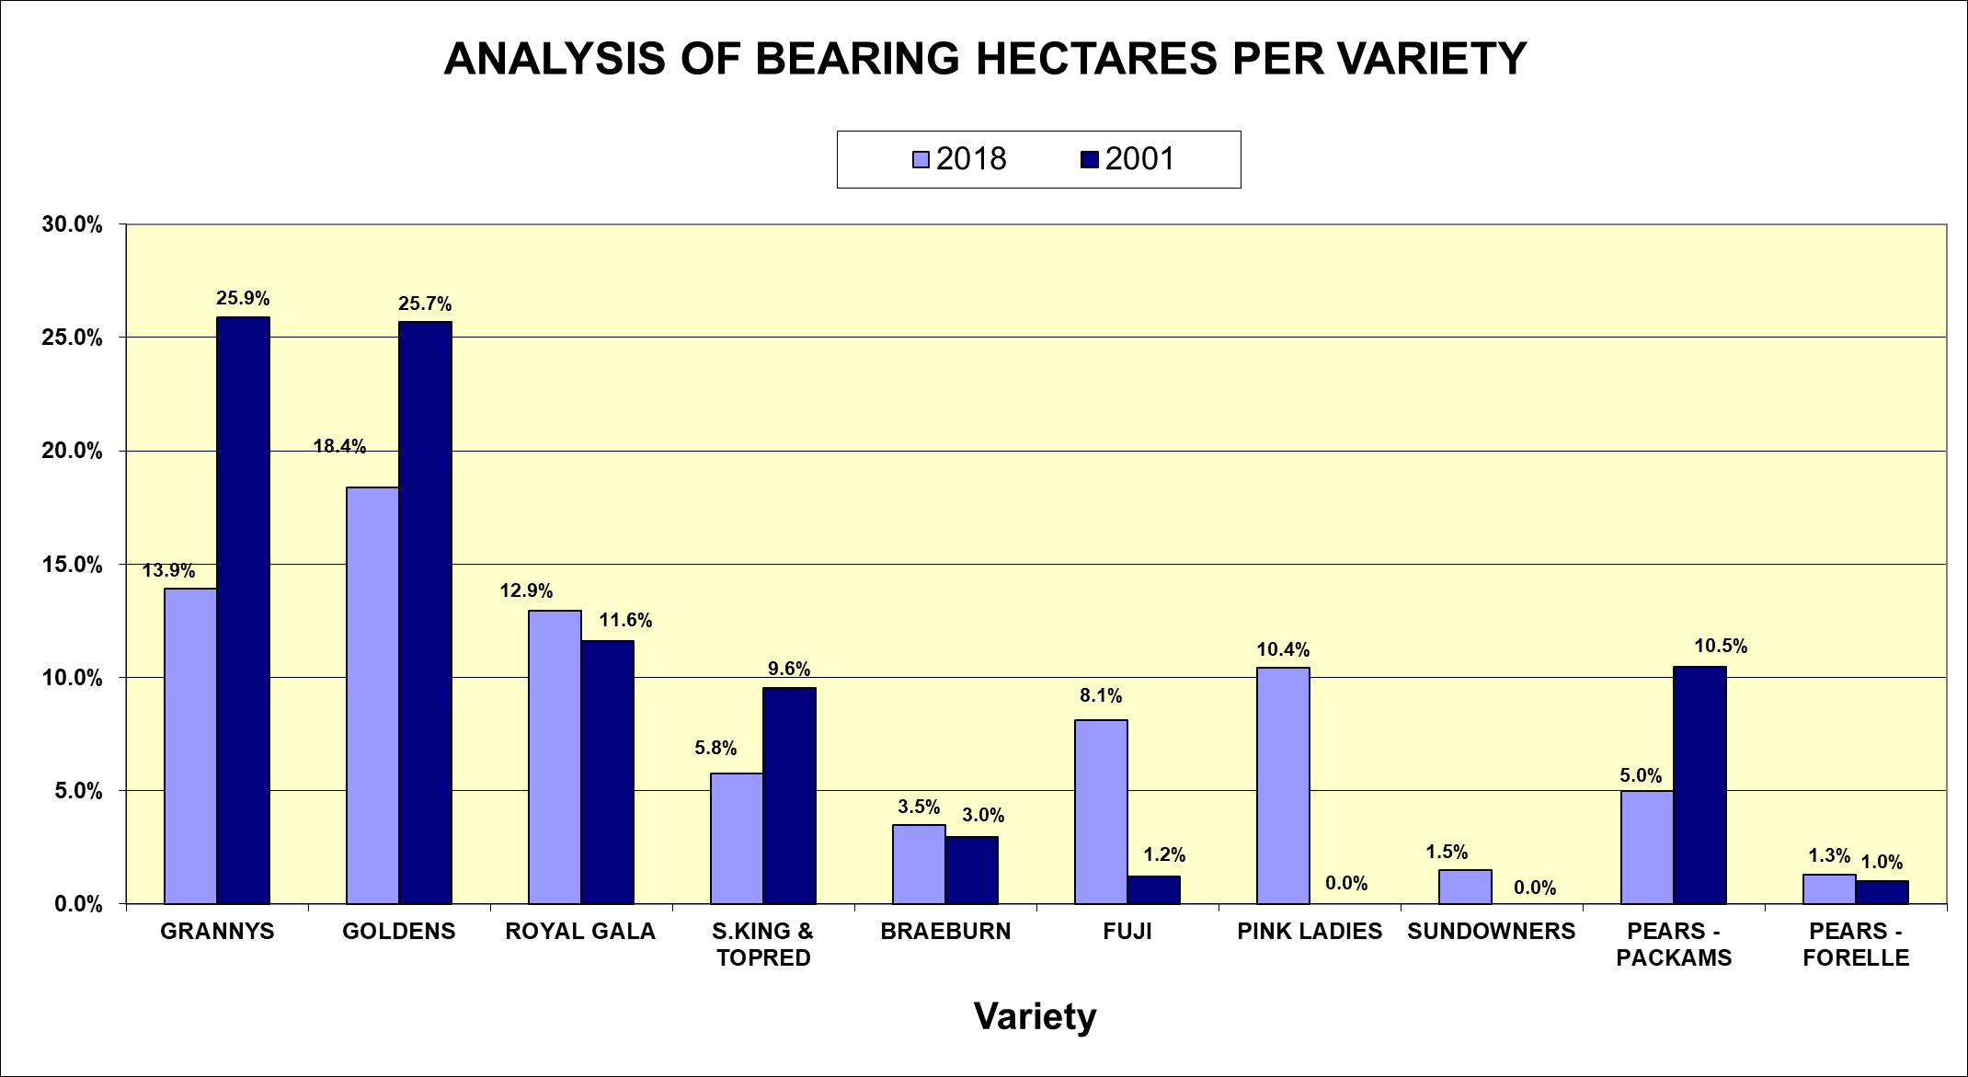
bdk auditors | Fruit Benchmarking survey 2019 10

Slide 8
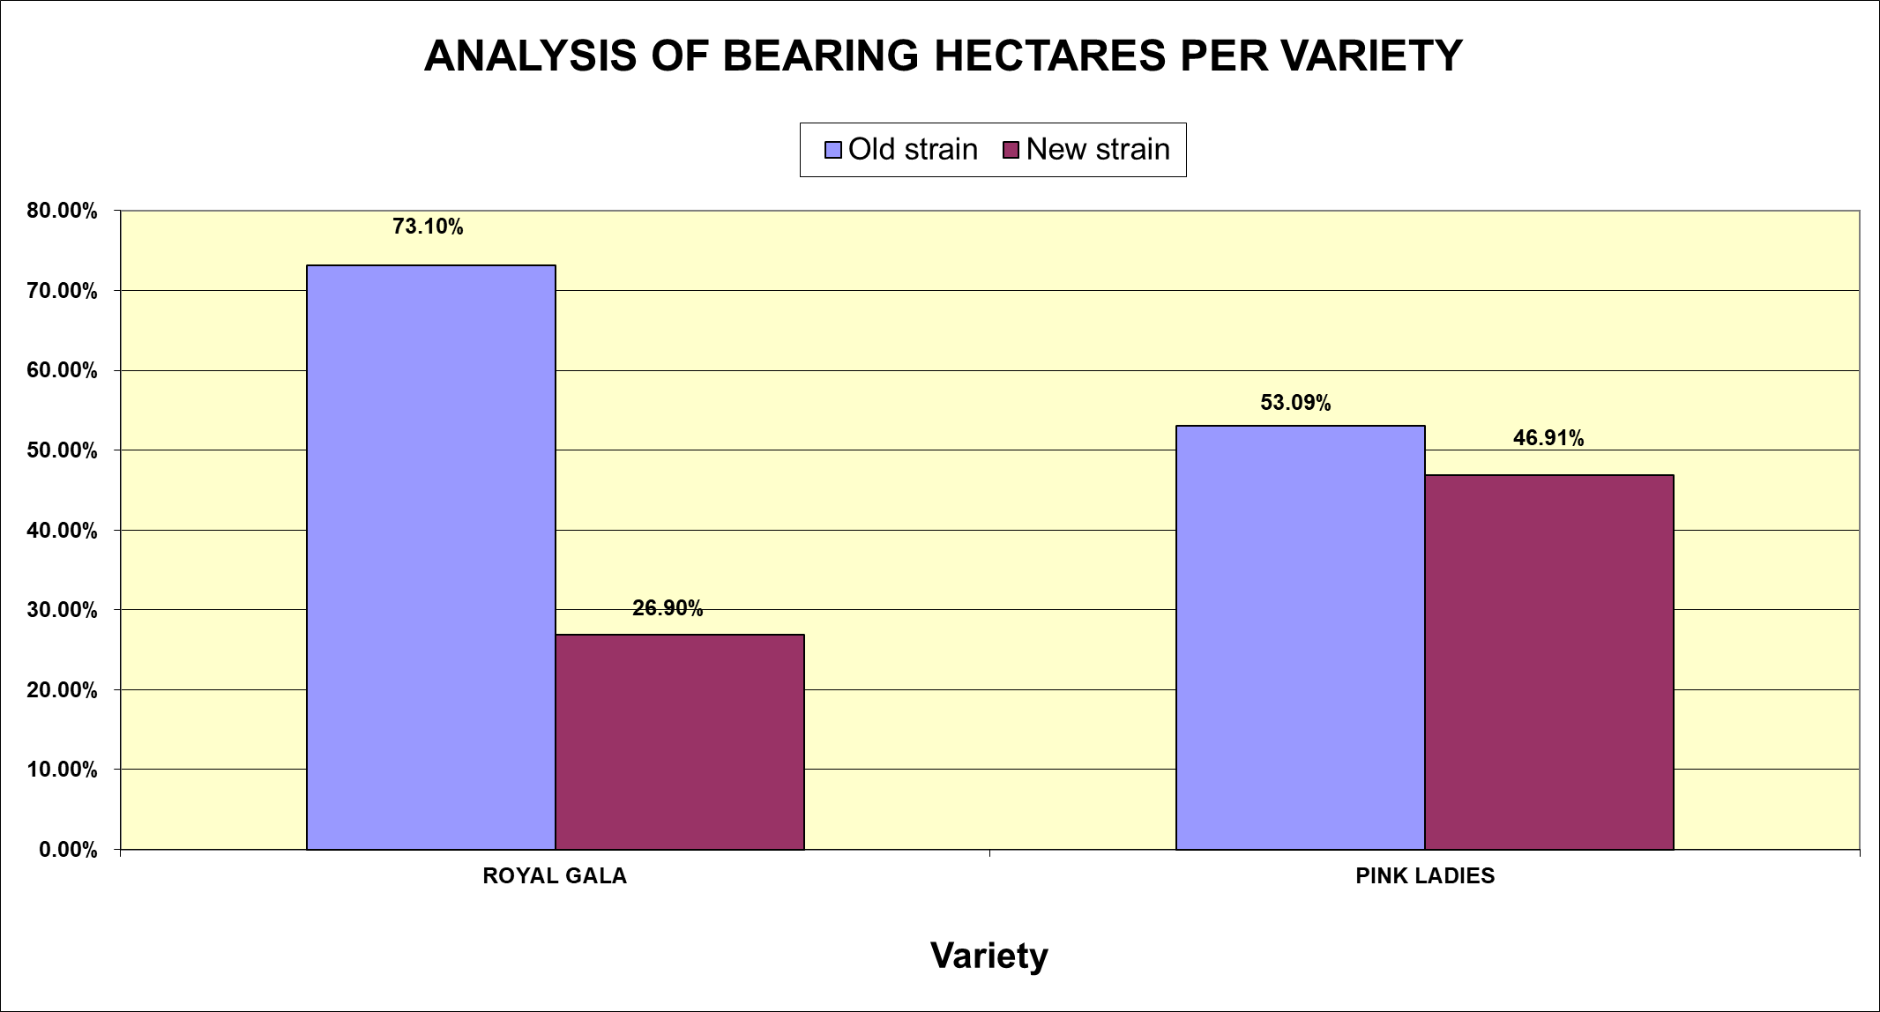
bdk auditors | Fruit Benchmarking survey 2019 10

Slide 9
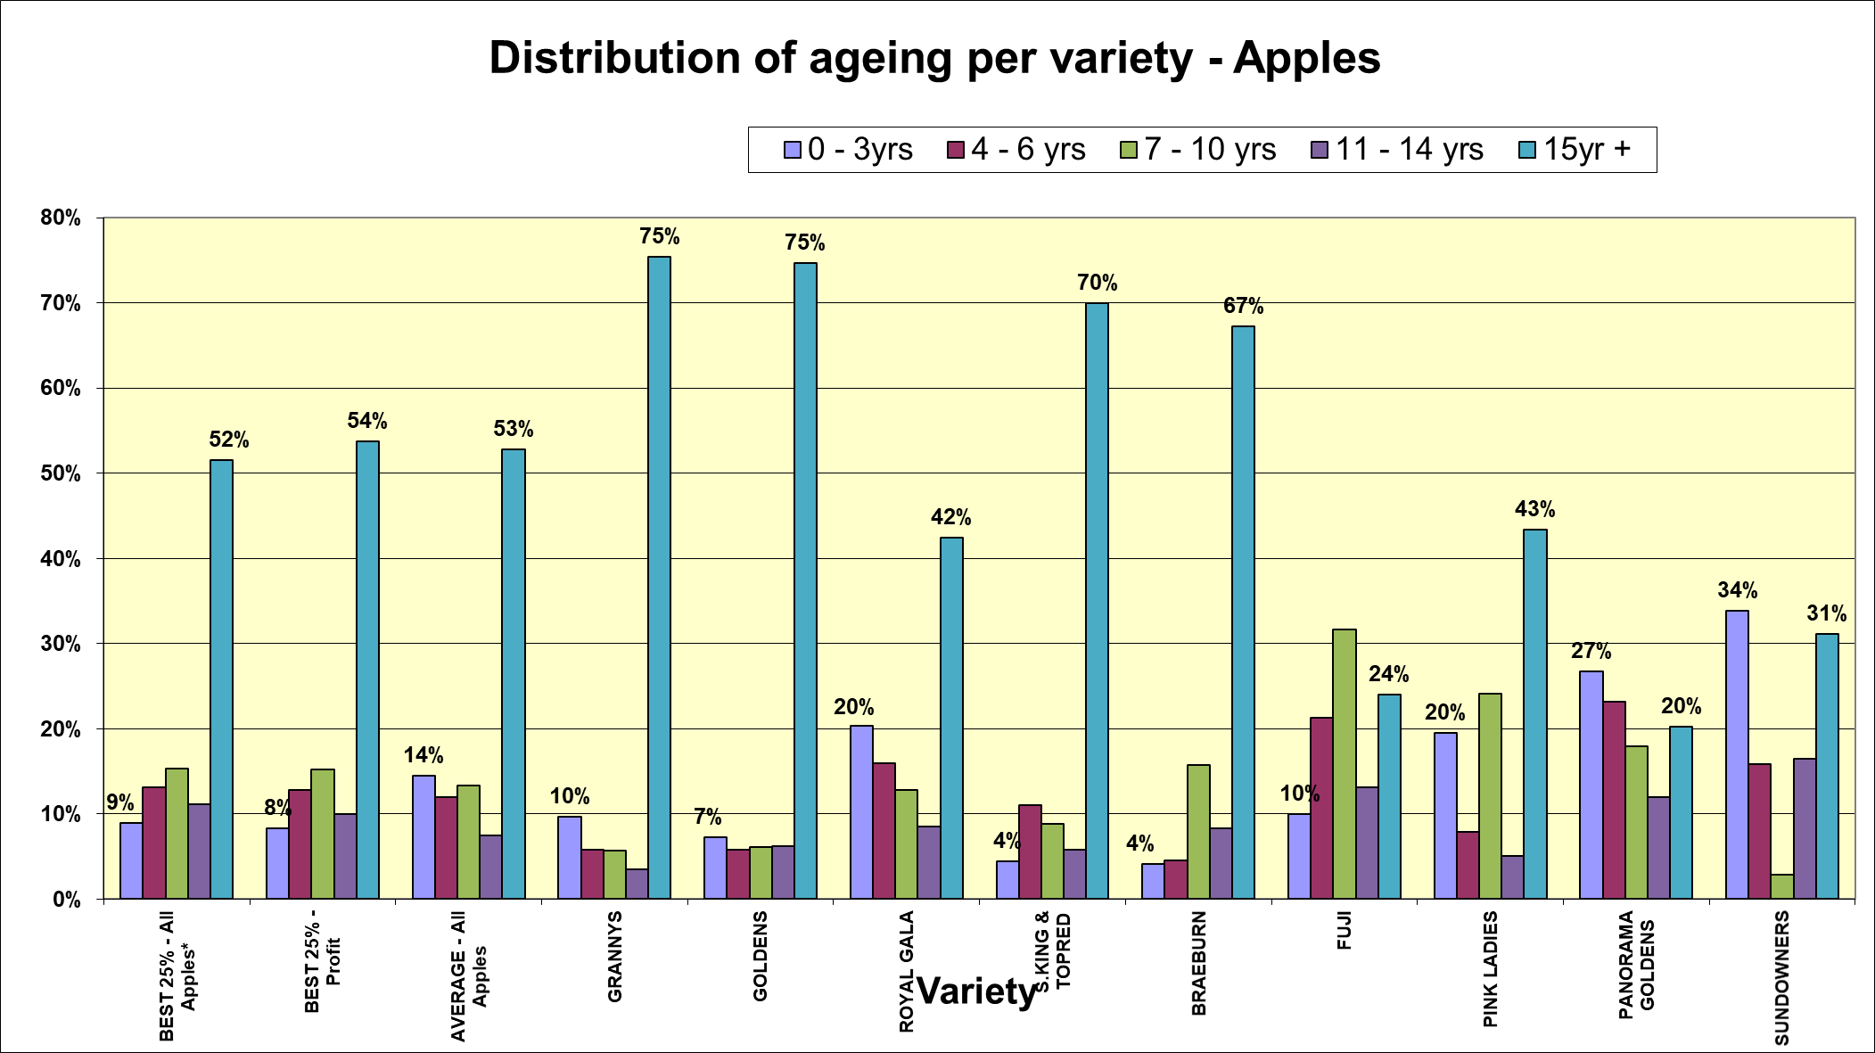
bdk auditors | Fruit Benchmarking survey 2019 10

Slide 10
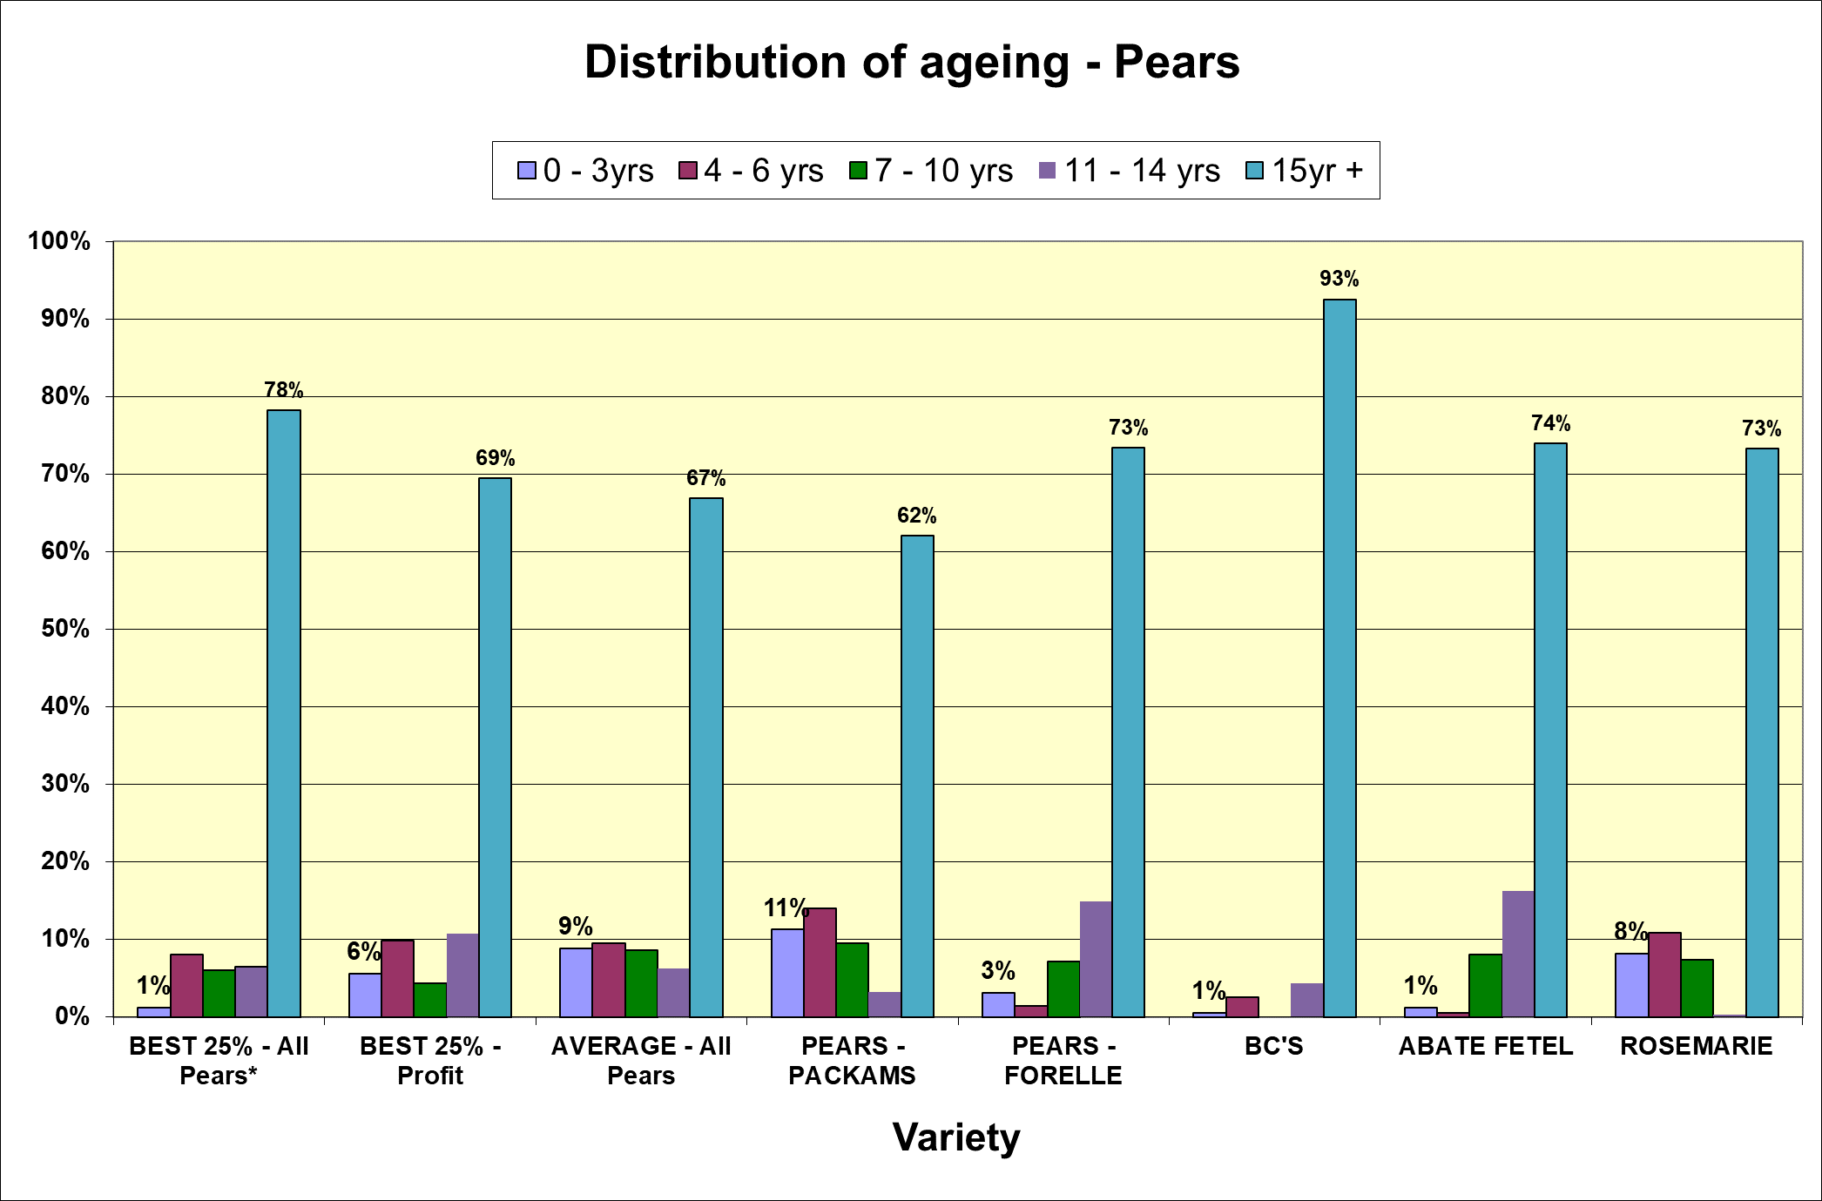
bdk auditors | Fruit Benchmarking survey 2019 10

Slide 11
BDK OUDITEURE OPNAME
BELANGRIKE BEGRIPPE
Geplante hektaar is hektaar onder bome.
Draende hektare is hektare in produksie, aangepas vir verwagte laer produksie by jong
bome. 'n Gewig word toegeken aan jong bome om voorsiening te maak vir verwagte
laer produksie by jong bome, bv.
Appels | 0 - 2 jr: |  | Tel as nul
 | 3 - 5 jr: |  | Tel as 50% van 'n hektaar
 | 6 plus jr: |  | Tel as 100% van hektaar
Produserende hektare is geplante hektare, aangepas met 'n faktor om voorsiening te
maak vir laer as normale produksiekoste in die onproduserende fase, bv.
Appels | 0 - 2 jr: |  | 60% van volle koste
 | 3 - 5 jr: |  | 78% van volle koste
 | 6 plus jr: |  | 100% van koste
Groepsgemiddelde is die geweegde gemiddelde van die plase wie se statistieke as
vergelykbaar beskou word.
Beste 25% is die geweegde gemmidelde van die plase met die 25% beste resultate
vir elke kategorie.
Kategorie | Kwaliteit | Kommentaar
Klas 1 | SA1/UK1 | UK of FE standaard
 | 1A/EU1 | EU Klas 1
 | 1R/RSA1 | Alle vrugte wat 'n PPECB EU1 sou kon wees, maar dit is na Afrika (Goldens en Packhams) toe uitgevoer
Klas 2 | 2A/EU2 | Klas 1 lokaal of klas 2 uitvoer
 | 1L
 | Lokaal1
Klas 2.5 | 1Z/2L | Enige vrugte wat gepak gaan word vir die varsmark, maar wat nie klas 1 lokaal (1L) is nie
 | Lokaal3
Klas 3 | Sap | Alle bulk/krat verkope
 | Plaasverkope
bdk auditors | Fruit Benchmarking survey 2019 10

Slide 12

p.12

Slide 13
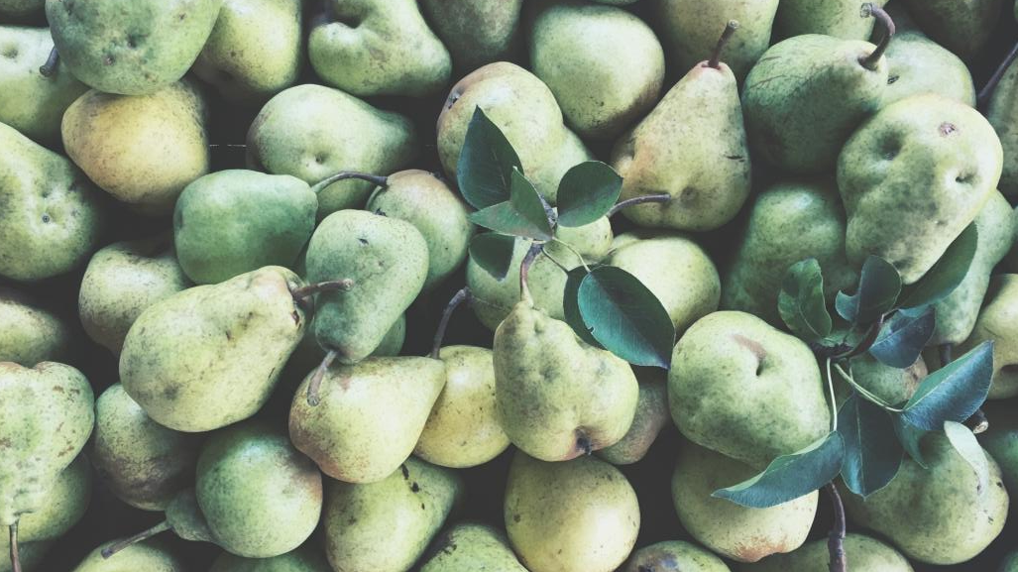

Exchange rate volatility
bdk auditors | Fruit Benchmarking survey 2018 Slide not in book

Slide 14
The effect of Exchange rate on Farm Income
Citrus Growers Association
“A 10% movement in exchange rate has a 30% effect on farm income”
A few events that had (or should have had) an effect on exchange rate in the last year
bdk auditors | Fruit Benchmarking survey 2019 10

Slide 15

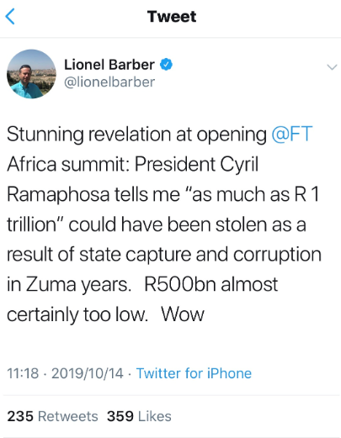
External politics and world events
Trump policies, protectionism and trade wars
Brexit 31 October?
Polish and Chinese harvest
Locally
Land expropriation
Zondo commission
Zuma fraud trial and attack on our judicial
Ports and the loss of shipping weeks
Rating agencies
Bail outs at our parastatel SAA, Eskom, Denel,
etc.
Xenophobia and the effect on our Nigerian
market
bdk auditors | Fruit Benchmarking survey 2019 10

Slide 16
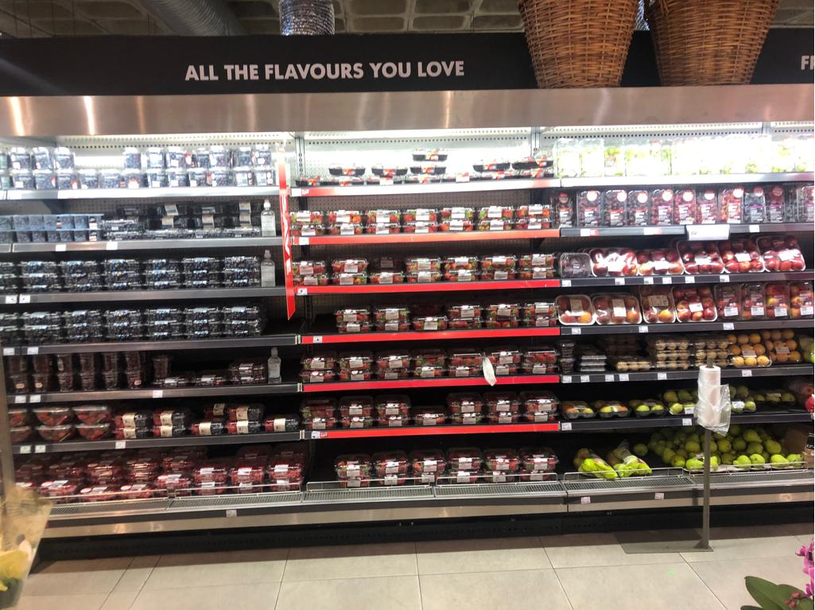
Consumer trends and habits
High income consumer spend
Influence of other fruit types
Markets and fruit spec of the future
bdk auditors | Fruit Benchmarking survey 2019 10

Slide 17

Benchmarking Survey: 2018/19
 | 2018 crop | Compounded | Compounded | Average prod
 | over previous | over 5 years | over 5 years | cost over 5 yrs
Average prices | year | normalised | per year | per ton
All Apples | 24% | 5% | 5% | 9%
Granny's | 22% | 3% | 5% | 9%
Goldens | 39% | 0% | 3% | 9%
Royal Galas | 14% | 8% | 5% | 9%
S. & Topred | 15% | 5% | 4% | 9%
Pink Ladies | 16% | 5% | 6% | 9%
Braeburn | 46% | 7% | 6% | 9%
Fuji | 24% | 6% | 4% | 9%
Sundowner | 15% | 3% | 5% | 9%
Packhams | 3% | 2% | 3% | 9%
Forelle | -11% | 1% | 0% | 9%
bdk auditors | Fruit Benchmarking survey 2019 Normalised = uses an average base year (2012,2013,2014) instead of only 2013 which was an exceptional year 10

Slide 18
 | 2018 crop | Compounded | Compounded | Average prod
 | over previous | over 5 years | over 5 years | cost over 5 yrs
Average prices | year | normalised | per year | per ton
Average Apple Income | Per ha | Per ha | Per ha | Per ha
per Hectare | 10% | 6% | 3% | 7%
Production Cost - Best Practice*
Per Ha | 15.9% | 8% | 8% | 8%
Per Ton | 20.5% | 7% | 9% | 9%
Production - Best Practice**
 |  |  | Average 5 yrs
All Apples Ton/Ha | 72 |  | 72
 |  |  | Compounded
% Change | -2.7% | 1% | -2%
Packouts
 |  |  | Average 5 yrs
All Apples Class 1 + 2 | 61% |  | 64%
 |  |  | Compounded
Profit - Best Practise* | 8% | 3% | -1%
* Best practice according to profit per producing hectare
** Best practice according to income per bearing hectare
bdk auditors | Fruit Benchmarking survey 2019 10

Slide 19
Benchmarking Survey: 2018/19
Average income per variety per ton (all classes)
 | 2018 | 2017 | 2016 | Top 25% | Compounded
 | Group | Group | Group | Compounded | over
Varieties | Average | Average | Average | 5 years | 5 years
Sundowners | 5,486 | 4,782 | 4,660 | 3% | 5%
Pink Ladies | 5,077 | 4,364 | 4,123 | 5% | 6%
Royal Galas | 5,017 | 4,391 | 4,446 | 8% | 5%
Forelle | 4,618 | 5,195 | 5,407 | 1% | 0%
Fuji | 4,557 | 3,664 | 4,825 | 6% | 4%
Braeburn's | 4,495 | 3,087 | 3,307 | 7% | 6%
Packhams | 4,404 | 4,261 | 4,943 | 2% | 3%
All Apples | 4,391 | 3,528 | 3,564 | 5% | 5%
Abate fetel | 4,245 | 4,094 | 5,358 | 0% | -4%
Granny's | 4,110 | 3,365 | 2,934 | 3% | 5%
S & Topred | 3,996 | 3,482 | 3,865 | 5% | 4%
Pan. Goldens | 3,958 | 3,006 | 4,217 | 1% | 3%
Rosemarie | 3,818 | 3,646 | 4,892 | 4% | 2%
Goldens | 3,597 | 2,586 | 2,639 | 0% | 3%
BC's | 3,433 | 2,998 | 3,191 | 5% | 6%
bdk auditors | Fruit Benchmarking survey 2019 10

Slide 20
Koste & Inkomste opname: 2018/19
Gemiddelde inkomste per hektaar
 |  |  |  |  | Saamgestel | Saamgestel
 | Vrugte | 2018 | 2017 | 2016 | oor 3 jaar | oor 5 jaar
 | Pink Ladies | 346,325 | 300,439 | 313,692 | -1% | 2%
 | Sundowners | 343,191 | 298,840 | 321,725 | -3% | 3%
 | Royal Galas | 297,032 | 300,077 | 278,156 | 3% | 6%
 | Alle Appels | 271,055 | 231,005 | 241,113 | 4% | 3%
 | Braeburn | 266,564 | 230,383 | 216,145 | 5% | 3%
 | Goldens | 261,190 | 200,555 | 202,156 | 9% | 1%
 | Granny's | 258,416 | 218,552 | 218,997 | 8% | 1%
 | Forelle | 257,096 | 245,842 | 279,559 | 9% | 8%
 | Fuji | 242,376 | 177,212 | 262,163 | 5% | 5%
 | Rosemarie | 240,220 | 224,308 | 328,914 | 12% | 9%
 | Abate fetel | 239,173 | 213,056 | 306,884 | 23% | 6%
 | Packhams | 234,092 | 268,439 | 259,393 | 4% | 2%
 | BC's | 196,232 | 180,386 | 179,036 | 18% | 3%
 | S & Topred | 180,572 | 172,323 | 202,298 | -1% | 0%
 | Ander Pere | 176,758 | 129,069 | 142,317 | 18% | 0%
 | Pan. Goldens | 161,858 | 127,522 | 238,454 | -6% | -6%
 | Pruime | 100,301 | 407,908 | 442,442 | -27% | -4%
bdk auditors | Fruit Benchmarking survey 2019 10

Slide 21
Trends over the past 8 years
Benchmarking Survey: 2018/19
Statistics for the 2019 harvest and expenses for the year ended 28 February 2019
Trends per hectare |  | 2018 | 2017 | 2018 | 2017 | 2013 | Compounded | Compounded
 |  | Like for like |  |  |  |  | normalised | over 5 yrs
Labour cost |  | R 79,924 | R 74,644 | R 78,761 | R 74,671 | R 56,551 | 7.7% | 6.85%
% change |  | 7.1% | 4% | 5.5% | 3.9% | 21.0%
Pesticides and fertiliser |  | R 29,437 | R 27,404 | R 29,419 | R 27,693 | R 22,322 | 6.9% | 5.68%
% change |  | 7.4% | -3% | 6.2% | -2.9% | 31.7%
Operating expenses |  | R 161,858 | R 148,950 | R 161,042 | R 149,060 | R 114,852 | 8.0% | 6.99%
% change |  | 8.7% | 4.0% | 8.0% | 3.9% | 24.9%
Bin production per hectare |  | 160 | 169 | 161 | 170 | 175 | 0.3% | -1.64%
Ton production per hectare |  | 60 | 63 | 60 | 64 | 66 | 0.2% | -1.75%
Income |  | R 232,883 | R 208,703 | R 236,837 | R 211,452 | R 207,967 | 5.3% | 2.63%
% change |  | 11.6% | -5.3% | 12% | -5% | 51.5%
Profit before interest, depreciation,
taxation and owner remuneration |  | R 71,026 | R 59,753 | R 75,795 | R 62,392 | R 93,115 | 0.8% | -4.03%
% change |  | 18.9% | -22.5% | 21% | -21% | 105.3%
Normalised = uses an average base year (2012,2013,2014) instead of only 2013 which was an exceptional year
bdk auditors | Fruit Benchmarking survey 2019 10

Slide 22
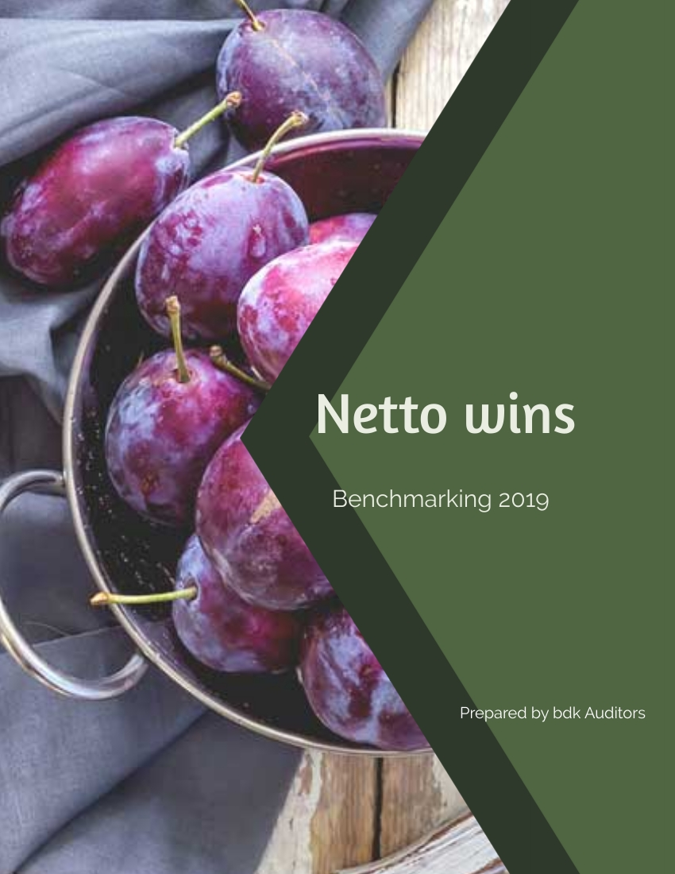
p.20

Slide 23
Benchmarking Survey: 2018/19
Average net profit per producing hectare
 |  | 2018 | 2018 | 2017 | 2017 | 2016 | 2015 | 2014 | 2013 | 2012 | 2011
 | Best practice* | 126,712 |  | 117,372
 | Group average profit |  | 75,795 |  | 62,392 | 79,161 | 75,869 | 80,130 | 93,115 | 45,361 | 21,814
 | Minimum profit needed | 46,540 | 46,540 | 44,324 | 44,324 | 42,213 | 40,203 | 38,288 | 36,465 | 34,729 | 33,075
 | Difference | 80,173 | 29,255 | 73,048 | 18,068 | 36,948 | 35,666 | 41,842 | 56,650 | 10,632 | -11,261
 | * Best practice according to profit per producing hectare
 | Conclusion
 | The average farm did make enough profits to be sustainable.
 | The best practice producers did make enough profit to be sustainable.
 | Average profit peaked in 2013
 | (Note: "Profit" is the profit before interest, depreciation, taxation and
 | owners remuneration.)
bdk auditors | Fruit Benchmarking survey 2019 10

Slide 24
Koste & Inkomste opname: 2018/19
Beraamde netto wins per variëteit per ha voor waardevermindering en rente
 |  |  |  | 2018 | 2018
 | Gemid. | Beste | Gemid. | Netto W. | Netto W.
Variëteit | Inkomste | Praktyk* | Koste | Gemid. | Beste Pr.
Pink Ladies | 346,325 | 487,266 | 161,042 | 185,283 | 326,224
Sundowners | 343,191 | 500,133 | 161,042 | 182,149 | 339,091
Royal Galas | 297,032 | 384,766 | 161,042 | 135,990 | 223,724
Alle Appels | 271,055 | 332,053 | 161,042 | 110,013 | 171,011
Braeburn | 266,564 | 341,403 | 161,042 | 105,522 | 180,361
Goldens | 261,190 | 346,480 | 161,042 | 100,148 | 185,438
Granny's | 258,416 | 315,716 | 161,042 | 97,374 | 154,674
Forelle | 257,096 | 318,996 | 161,042 | 96,054 | 157,954
Fuji | 242,376 | 320,738 | 161,042 | 81,334 | 159,696
Abate fetel | 239,173 | 327,693 | 161,042 | 78,131 | 166,651
Rosemarie | 240,220 | 340,910 | 161,042 | 79,178 | 179,868
Packhams | 234,092 | 325,021 | 161,042 | 73,050 | 163,979
BC's | 196,232 | 287,512 | 161,042 | 35,190 | 126,470
S. & Topred | 180,572 | 236,242 | 161,042 | 19,529 | 75,200
Pan. Goldens | 161,858 | 302,508 | 161,042 | 816 | 141,466
* Beste praktyk volgens inkomste per draende hektaar
bdk auditors | Fruit Benchmarking survey 2019 10

Slide 25
Benchmarking Survey: 2018/19
Index for varieties
 | 2018 |  | 2017
 | Average | Best 25%* | Average | Best 25%*
Pink Ladies | 1.00 | 1.00 | 1.00 | 1.00
Sundowners | 1.02 | 0.96 | 1.00 | 1.12
Royal Galas | 1.36 | 1.46 | 1.01 | 1.07
Braeburn | 1.76 | 1.81 | 1.56 | 1.55
Goldens | 1.85 | 1.76 | 1.86 | 2.14
Granny's | 1.90 | 2.11 | 2.01 | 2.22
Forelle | 1.93 | 2.07 | 2.18 | 2.18
Fuji | 2.28 | 2.04 | 2.37 | 2.13
Rosemarie | 2.34 | 1.81 | 4.83 | 4.12
Abate fetel | 2.37 | 1.96 | 2.94 | 2.49
Packhams | 2.54 | 1.99 | 5.38 | 3.44
BC's | 5.27 | 2.58 | 6.51 | 3.02
S. & Topred | 9.49 | 2.58 | loss | 2.24
Pan. Goldens | 227.00 | 4.34 | loss | 2.24
How many hectares of a variety gives the
same profit as a hectare of Pink Ladies?
* Best practice according to income per bearing hectare
bdk auditors | Fruit Benchmarking survey 2019 10

Slide 26
NETTO WINS PER PRODUSERENDE HEKTAAR 2018/19
 |  |  | Beste | Beste | MY PLAAS
 | Gem18/19 | Gem17/18 | 25 % 18/19 | 25 % 17/18 | 2018
Inkomste | 236,837 | 211,452 | 286,298 | 255,053 | 266,702
(Inkomste per draende hektaar): | 264,371 | 234,630 | 308,092 | 278,895 | 271,478
Min Uitgawes: | 161,042 | 149,060 | 159,585 | 137,681 | 134,588
Totale arbeidskoste | 76,935 | 72,654 | 76,653 | 65,533 | 58,761
(Uitgesluit winsdeel)
Winsdeel | 1,826 | 2,016 | 2,819 | 3,669 | 7,732
Oesbeskermning | 23,723 | 22,803 | 23,052 | 19,392 | 21,268
(Ingesluit onkruidoder)
Kunsmis | 5,696 | 4,890 | 5,598 | 5,103 | 4,128
Reparasies | 11,482 | 10,795 | 11,787 | 10,873 | 10,627
(uitgesluit geboue)
Reparasies geboue | 5,228 | 3,941 | 4,972 | 2,133 | 1,347
Brandstof & olie | 8,065 | 7,059 | 8,136 | 6,948 | 5,146
Vervoer | 4,901 | 3,379 | 4,911 | 2,248 | 5,918
Elektrisiteit | 6,129 | 5,671 | 6,070 | 5,762 | 6,138
Mulch, chips, kompos, strooi | 780 | 2,964 | 755 | 3,046 | 427
Huur (Plaastoerusting & Bye) | 2,864 | 2,013 | 2,839 | 1,331 | 1,721
Boordbenodighede & tegniese dienste | 3,068 | 1,215 | 2,953 | 1,127
Versekering | 2,041 | 2,015 | 1,260 | 1,924 | 550
Water | 1,076 | 1,335 | 1,280 | 2,294 | 960
Sekuriteit | 1,228 | 1,101 | 1,251 | 1,311 | 1,547
Telefoon & internet | 643 | 634 | 609 | 601 | 336
Ander uitgawes | 4,579 | 4,572 | 4,641 | 4,385 | 7,109
Wins/- verlies per produserende hektaar | 75,795 | 62,392 | 126,712 | 117,372 | 132,114
Wins/- verlies per prod hektaar uitgsl. winsdeel | 77,621 | 64,408 | 129,532 | 121,041 | 139,846
bdk auditors | Fruit Benchmarking survey 2019 10

Slide 27
NETTO WINS PER PRODUSERENDE HEKTAAR 2018/19
 |  |  | Beste | Beste | MY PLAAS
 | Gem18/19 | Gem17/18 | 25 % 18/19 | 25 % 17/18 | 2018
Totale uitgawes per ton geproduseer | 2,975 | 2,590 | 2,547 | 2,114 | 2,300
Total arbeidskoste per ton geproduseer | 1,421 | 1,262 | 1,223 | 1,006 | 1,004
Oesbeskerming en kunsmis per ton geprod. | 543 | 481 | 457 | 359 | 434
Totale inkomste per ton geproduseer | 4,375 | 3,674 | 4,569 | 3,917 | 4,558
Inkomste per ton indeks | 96 | 94 | 100 | 100 | 100
Ton per ha. | 60 | 64 | 67 | 71 | 60
Wins per ton | 1,400 | 1,084 | 2022 | 1,802 | 2,258
Wins per ha indeks | 60 | 53 | 100 | 100 | 104
Wins per ton indeks | 69 | 60 | 100 | 100 | 112
Uitgawe per ha indeks | 101 | 108 | 100 | 100 | 84
Uitgawe per ton indeks | 117 | 123 | 100 | 100 | 90
Produksie indeks | 90 | 90 | 100 | 100 | 88
Netto wins voor rente betaal, |  |  | *
waardevermindering en kapitale investering
* = Profiel van die plase met die beste 25% wins per produserende hektaar
bdk auditors | Fruit Benchmarking survey 2019 10

Slide 28

p.52

Slide 29
Koste & Inkomste opname: 2018/19
Beste praktyk vs Groepsgemiddelde
Vergelyk met netto wins per produserende ha.:
 |  | 2018 | 2017 | 2016 | 2015 | 2014 | 2013 | 2012 | 2011 | 2010 | 2009
 | Groepsgemiddelde | 75,795 | 62,392 | 79,161 | 75,869 | 80,130 | 93,115 | 41,312 | 21,814 | 4,961 | 20,086
 | Beste praktyk* | 126,712 | 117,372 | 120,305 | 125,914 | 119,853 | 135,209 | 72,089 | 52,277 | 27,909 | 48,367
 | Verskil | 50,917 | 54,980 | 41,143 | 50,045 | 39,723 | 42,094 | 30,463 | 22,948 | 28,281 | 27,278
 | * Beste praktyk volgens wins per produserende hektaar
 | Gevolgtrekking
 | Daar is sowat R50,917 (2017: R 54,980) wins per ha. verskil tussen
 | beste praktyk en die gemiddelde boer.
bdk auditors | Fruit Benchmarking survey 2019 10

Slide 30
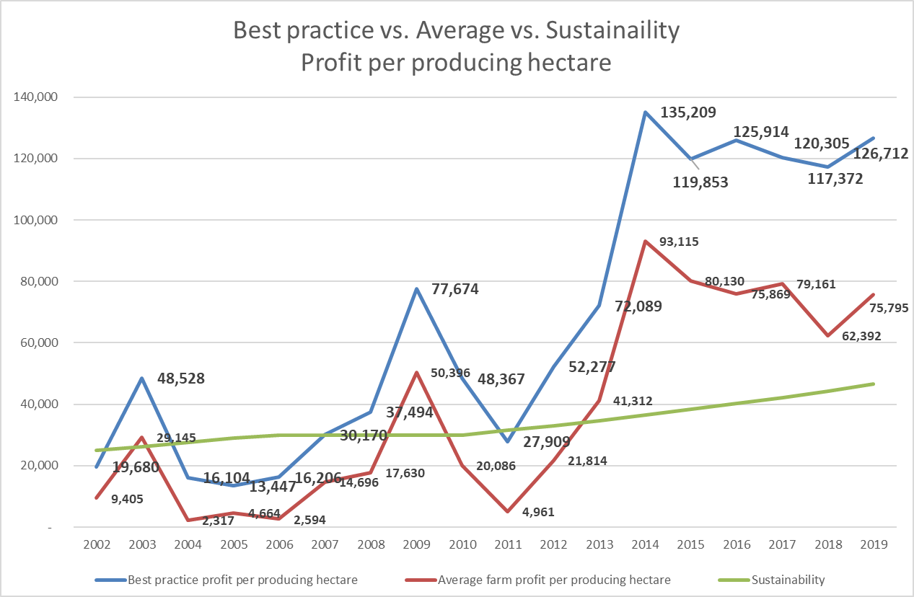
bdk auditors | Fruit Benchmarking survey 2019 10

Slide 31
Koste & Inkomste opname: 2018/19
Beraamde netto wins per variëteit per ha voor waardevermindering en rente
 |  |  |  | 2018 | 2018
 | Gemid. | Beste | Gemid. | Netto W. | Netto W.
Variëteit | Inkomste | Praktyk* | Koste | Gemid. | Beste Pr.
Pink Ladies | 346,325 | 487,266 | 161,042 | 185,283 | 326,224
Sundowners | 343,191 | 500,133 | 161,042 | 182,149 | 339,091
Royal Galas | 297,032 | 384,766 | 161,042 | 135,990 | 223,724
Alle Appels | 271,055 | 332,053 | 161,042 | 110,013 | 171,011
Braeburn | 266,564 | 341,403 | 161,042 | 105,522 | 180,361
Goldens | 261,190 | 346,480 | 161,042 | 100,148 | 185,438
Granny's | 258,416 | 315,716 | 161,042 | 97,374 | 154,674
Forelle | 257,096 | 318,996 | 161,042 | 96,054 | 157,954
Fuji | 242,376 | 320,738 | 161,042 | 81,334 | 159,696
Abate fetel | 239,173 | 327,693 | 161,042 | 78,131 | 166,651
Rosemarie | 240,220 | 340,910 | 161,042 | 79,178 | 179,868
Packhams | 234,092 | 325,021 | 161,042 | 73,050 | 163,979
BC's | 196,232 | 287,512 | 161,042 | 35,190 | 126,470
S. & Topred | 180,572 | 236,242 | 161,042 | 19,529 | 75,200
Pan. Goldens | 161,858 | 302,508 | 161,042 | 816 | 141,466
* Beste praktyk volgens inkomste per draende hektaar
bdk auditors | Fruit Benchmarking survey 2019 10

Slide 32
Koste & Inkomste opname: 2018/19
Saamgestelde verbetering van die top25% netto wins pervariëteit per ha voor waardevermindering en rente
 | 2018 | 2013
 | Wins | Wins
Variëteit | Verskil | Verskil
Pink Ladies | 140,940 | 112,425 | 5%
Sundowners | 156,942 | 70,443 | 17%
Royal Galas | 87,734 | 72,681 | 4%
Alle Appels | 60,997 | 43,397 | 7%
Braeburn | 74,838 | 74,057 | 0%
Goldens | 85,290 | 53,065 | 10%
Granny's | 57,300 | 52,203 | 2%
Forelle | 61,901 | 55,717 | 2%
Fuji | 78,362 | 106,157 | -6%
Abate fetel | 88,520 | 69,362 | 5%
Rosemarie | 100,690 | 109,807 | -2%
Packhams | 90,929 | 51,435 | 12%
BC's | 91,280 | 46,768 | 14%
S. & Topred | 55,670 | 79,130 | -7%
Pan. Goldens | 140,650 | 177,741 | -5%
bdk auditors | Fruit Benchmarking survey 2019 10

Slide 33
Benchmarking Survey: 2018/19
Capital allocation and returns
Nr | Omvang van opname | 2018
1. | Hektare onder bome | 5,209 ha
2. | Arbeidskoste | R 398.92 mil
3. | Spuitstowwe en kunsmis | R 143.23 mil
4. | Brandstof & vervoer | R 61.71 mil
5. | Lopende koste voor rente
 | en waardevermindering | R 774.64 mil
6. | Ekwivalente krat produksie | 676,618 kratte
7. | Gemiddelde produksie | 58 ton/ha
8. | Inkomste alle variëteite | R 1085.0 mil
9. | Inkomste alle appels | R 907.77 mil
Totale EBITDA | 310,360,000
Totale bates @R500,000 p/ha | 2,604,500,000
 | 12%
Netto ekwiteit @ 35% skuld | 1,692,925,000
 | 18%
bdk auditors | Fruit Benchmarking survey 2019 10

Slide 34
Benchmarking Survey: 2018/19
Capital allocation and returns
 | Jaar | 0 | 1 | 2 | 3 | 4 | 5 | 6
 | Uitvloei | -500,000 | -96,625 | -96,625 | -125,613 | -125,613 | -125,613 | -161,042
 | Invloei @ 75% beste praktyk Pink Ladies |  |  |  | 182,725 | 182,725 | 182,725 | 365,449
 |  | -500,000 | -96,625 | -96,625 | 57,112 | 57,112 | 57,112 | 204,407
IRR | Income tax |  | 27,055 | 27,055 | -15,991 | -15,991 | -15,991 | -57,234
 | Capital development allowance |  | 140,000
 | Nett after tax | -500,000 | 70,430 | -69,570 | 41,121 | 41,121 | 41,121 | 147,173
NPV | R | -500,000 | -429,570 | -499,140 | -458,020 | -416,899 | -375,779 | -228,606
bdk auditors | Fruit Benchmarking survey 2019 10

Slide 35
Benchmarking Survey: 2018/19
Capital allocation and returns
 | Jaar | 7 | 8 | 9 | 10 | 11 | 12
 | Uitvloei | -161,042 | -161,042 | -161,042 | -161,042 | -161,042 | -161,042
 | Invloei @ 75% beste praktyk Pink Ladies | 365,449 | 365,449 | 365,449 | 365,449 | 365,449 | 365,449
 |  | 204,407 | 204,407 | 204,407 | 204,407 | 204,407 | 204,407
IRR | Income tax | -57,234 | -57,234 | -57,234 | -57,234 | -57,234 | -57,234
 | Capital development allowance
 | Nett after tax | 147,173 | 147,173 | 147,173 | 147,173 | 147,173 | 147,173
NPV |  | -81,432 | 65,741 | 212,914 | 360,087 | 507,261 | 654,434
bdk auditors | Fruit Benchmarking survey 2019 10

Slide 36
Benchmarking Survey: 2018/19
Capital allocation and returns
Jaar | 13 | 14 | 15 | 16 | 17 | 18 | 19 | 20
Uitvloei | -161,042 | -161,042 | -161,042 | -161,042 | -161,042 | -161,042 | -161,042 | -161,042
Invloei @ 75% beste praktyk Pink Ladies | 365,449 | 365,449 | 365,449 | 365,449 | 365,449 | 365,449 | 365,449 | 365,449
 | 204,407 | 204,407 | 204,407 | 204,407 | 204,407 | 204,407 | 204,407 | 204,407
Income tax | -57,234 | -57,234 | -57,234 | -57,234 | -57,234 | -57,234 | -57,234 | -57,234
Capital development allowance
Nett after tax | 147,173 | 147,173 | 147,173 | 147,173 | 147,173 | 147,173 | 147,173 | 147,173
R716,594.51 | 801,607 | 948,780 | 1,095,953 | 1,243,127 | 1,390,300 | 1,537,473 | 1,684,646 | 1,831,819
bdk auditors | Fruit Benchmarking survey 2019 10

Slide 37
Benchmarking Survey: 2018/19
Capital allocation and returns
 | Jaar | 0 | 1 | 2 | 3 | 4 | 5 | 6
 | Uitvloei | -500,000 | -96,625 | -96,625 | -125,613 | -125,613 | -125,613 | -161,042
 | Invloei @ 75% beste praktyk Pink Ladies |  |  |  | 182,725 | 182,725 | 182,725 | 365,449
 |  | -500,000 | -96,625 | -96,625 | 57,112 | 57,112 | 57,112 | 204,407
IRR | Income tax |  | 27,055 | 27,055 | -15,991 | -15,991 | -15,991 | -57,234
 | Capital development allowance |  | 140,000
 | Nett after tax | -500,000 | 70,430 | -69,570 | 41,121 | 41,121 | 41,121 | 147,173
NPV | R | -500,000 | -429,570 | -499,140 | -458,020 | -416,899 | -375,779 | -228,606
 | Wins op gewone Goldens |  | 100,148 | 100,148 | 100,148 | 100,148 | 100,148 | 100,148
 | Income tax |  | -28,041 | -28,041 | -28,041 | -28,041 | -28,041 | -28,041
 | Nett after tax |  | 72,107 | 72,107 | 72,107 | 72,107 | 72,107 | 72,107
NPV | R |  | 72,107 | 144,213 | 216,320 | 288,427 | 360,533 | 432,640
bdk auditors | Fruit Benchmarking survey 2019 10

Slide 38
Benchmarking Survey: 2018/19
Capital allocation and returns
 | Jaar | 7 | 8 | 9 | 10 | 11 | 12
 | Uitvloei | -161,042 | -161,042 | -161,042 | -161,042 | -161,042 | -161,042
 | Invloei @ 75% beste praktyk Pink Ladies | 365,449 | 365,449 | 365,449 | 365,449 | 365,449 | 365,449
 |  | 204,407 | 204,407 | 204,407 | 204,407 | 204,407 | 204,407
IRR | Income tax | -57,234 | -57,234 | -57,234 | -57,234 | -57,234 | -57,234
 | Capital development allowance
 | Nett after tax | 147,173 | 147,173 | 147,173 | 147,173 | 147,173 | 147,173
NPV |  | -81,432 | 65,741 | 212,914 | 360,087 | 507,261 | 654,434
 | Wins op gewone Goldens | 100,148 | 100,148 | 100,148 | 100,148 | 100,148 | 100,148
 | Income tax | -28,041 | -28,041 | -28,041 | -28,041 | -28,041 | -28,041
 | Nett after tax | 72,107 | 72,107 | 72,107 | 72,107 | 72,107 | 72,107
NPV | R | 504,747 | 576,853 | 648,960 | 721,067 | 793,173 | 865,280
bdk auditors | Fruit Benchmarking survey 2019 10

Slide 39
Benchmarking Survey: 2018/19
Capital allocation and returns
 | Jaar | 13 | 14 | 15 | 16 | 17 | 18 | 19 | 20
 | Uitvloei | -161,042 | -161,042 | -161,042 | -161,042 | -161,042 | -161,042 | -161,042 | -161,042
 | Invloei @ 75% beste praktyk Pink Ladies | 365,449 | 365,449 | 365,449 | 365,449 | 365,449 | 365,449 | 365,449 | 365,449
 |  | 204,407 | 204,407 | 204,407 | 204,407 | 204,407 | 204,407 | 204,407 | 204,407
IRR | Income tax | -57,234 | -57,234 | -57,234 | -57,234 | -57,234 | -57,234 | -57,234 | -57,234
 | Capital development allowance
15% | Nett after tax | 147,173 | 147,173 | 147,173 | 147,173 | 147,173 | 147,173 | 147,173 | 147,173
NPV | R716,594.51 | 801,607 | 948,780 | 1,095,953 | 1,243,127 | 1,390,300 | 1,537,473 | 1,684,646 | 1,831,819
 | Wins op gewone Goldens | 100,148 | 100,148 | 100,148 | 100,148 | 100,148 | 100,148 | 100,148 | 100,148
 | Income tax | -28,041 | -28,041 | -28,041 | -28,041 | -28,041 | -28,041 | -28,041 | -28,041
 | Nett after tax | 72,107 | 72,107 | 72,107 | 72,107 | 72,107 | 72,107 | 72,107 | 72,107
NPV | R574,208.98 | 937,387 | 1,009,493 | 1,081,600 | 1,153,707 | 1,225,813 | 1,297,920 | 1,370,027 | 1,442,133
bdk auditors | Fruit Benchmarking survey 2019 10

Slide 40
32
NETTO WINS PER PRODUSERENDE HEKTAAR 2018/2019 JAAR
 | Per ha | Beste per ha | Verskil
 | Gem’18 | 25 % 18 | per ha
Inkomste | 236,837 | 286,298 | 49,460
(Inkomste per draende hektaar): | 264,371 | 308,092 | 43,721
Min Uitgawes: | 161,042 | 159,585 | (1,457)
Totale arbeidskoste | 76,935 | 76,653 | (282)
(Uitgesluit winsdeel)
Winsdeel | 1,826 | 2,819 | 993
Oesbeskermning | 23,723 | 23,052 | (671)
(Ingesluit onkruidoder)
Kunsmis | 5,696 | 5,598 | (98)
Reparasies | 11,482 | 11,787 | 305
(uitgesluit geboue)
Reparasies geboue | 5,228 | 4,972 | (256)
Brandstof & olie | 8,065 | 8,136 | 70
Vervoer | 4,901 | 4,911 | 10
Elektrisiteit | 6,129 | 6,070 | (59)
Mulch, chips, kompos, strooi | 780 | 755 | (24)
Huur (Plaastoerusting & Bye) | 2,864 | 2,839 | (25)
Boordbenodighede & tegniese koste | 3,068 | 2,953 | (115)
Versekering | 2,041 | 1,260 | (781)
Water | 1,076 | 1,280 | 204
Sekuriteit | 1,228 | 1,251 | 24
Telefoon & internet | 643 | 609 | (34)
Ander uitgawes | 4,579 | 4,641 | 61
Wins/- verlies per produserende hektaar | 75,795 | 117,372 | 50,917
Produksie per hektaar | 60 | 71
bdk auditors | Fruit Benchmarking survey 2018 32

Slide 41
32
NETTO WINS PER PRODUSERENDE TON 2018/2019 JAAR
 | Per ha | Beste per ha | Verskil | Per ton | Beste per ton | Verskil
 | Gem’18 | 25 % 18 | per ha | Gem’18 | 25 % 18 | per ton
Inkomste | 236,837 | 286,298 | 49,460 | 3,920 | 4,246 | 327
(Inkomste per draende hektaar): | 264,371 | 308,092 | 43,721 | 4,375 | 4,569 | 194
Min Uitgawes: | 161,042 | 159,585 | (1,457) | 2,665 | 2,367 | (298)
Totale arbeidskoste | 76,935 | 76,653 | (282) | 1,273 | 1,137 | (136)
(Uitgesluit winsdeel)
Winsdeel | 1,826 | 2,819 | 993 | 30.2 | 41.8 | 12
Oesbeskermning | 23,723 | 23,052 | (671) | 393 | 342 | (51)
(Ingesluit onkruidoder)
Kunsmis | 5,696 | 5,598 | (98) | 94 | 83 | (11)
Reparasies | 11,482 | 11,787 | 305 | 190 | 175 | (15)
(uitgesluit geboue)
Reparasies geboue | 5,228 | 4,972 | (256) | 87 | 74 | (13)
Brandstof & olie | 8,065 | 8,136 | 70 | 133 | 121 | (13)
Vervoer | 4,901 | 4,911 | 10 | 81 | 73 | (8)
Elektrisiteit | 6,129 | 6,070 | (59) | 101 | 90 | (11)
Mulch, chips, kompos, strooi | 780 | 755 | (24) | 13 | 11 | (2)
Huur (Plaastoerusting & Bye) | 2,864 | 2,839 | (25) | 47 | 42 | (5)
Boordbenodighede & tegniese koste | 3,068 | 2,953 | (115) | 51 | 44 | (7)
Versekering | 2,041 | 1,260 | (781) | 34 | 19 | (15)
Water | 1,076 | 1,280 | 204 | 18 | 19 | 1
Sekuriteit | 1,228 | 1,251 | 24 | 20 | 18.6 | (2)
Telefoon & internet | 643 | 609 | (34) | 11 | 9 | (2)
Ander uitgawes | 4,579 | 4,641 | 61 | 76 | 69 | (7)
Wins/- verlies per produserende hektaar | 75,795 | 117,372 | 50,917 | 1,254 | 1,879 | 625
Produksie per hektaar | 60 | 71
+8% +1%
-11% -1%
+50% +5%
bdk auditors | Fruit Benchmarking survey 2018 32

Slide 42
INKOMSTE VIR ALLE APPELS PER TON 2018/19
 |  |  | Verskil
 | Swakste | Beste | Beste min
 | 25% '18 | 25% '18 | swakste
Inkomste vergelykings per ton
Inkomste per hektaar | 237,067 | 320,330 | 83,263
Gemiddelde inkomste per ton | 4,015 | 4,586 | 572
Klas 1 en Klas 2 inkomste per ton | 5,781 | 6,626
Totale klas 1 inkomste per ton | 6,858 | 7,358
TON PER HEKTAAR APPELS GEPRODUSEER
Klas 1 ton per hektaar | 26 | 33 | 7
Klas 2 ton per hektaar | 9 | 10 | 0
Klas 2.5 ton per hektaar | 5 | 8 | 3
Klas 3 ton per hektaar | 18 | 19 | 0
Totale produksie per hektaar | 59 | 70 | 11
% Klas 1 en Klas 2 van totaal | 60% | 61%
 | $ | *
bdk auditors | Fruit Benchmarking survey 2019 10

Slide 43
INKOMSTE VIR ALLE APPELS PER TON 2018/19
 |  |  | Verskil
 | Swakste | Beste | Beste min
 | 25% '18 | 25% '18 | swakste
Afwyking in inkomste per hektaar beste & swakste 25% | 83,263 | 100%
Verklaar as volg:
Verskil in tonne @ beste 25% inkomste per ton | 49,516 | 59%
Produksie ( ton) teen verskil in prys | 33,747 | 41%
BELANGRIK:
Prys verskille is 'n faktor van variëteit samestelling, vruggroote, kwaliteit
samestelling en verpakking/bemarking.
* = Produsente met die beste 25% wins per produserende hektaar
$ = Produsente met die swakste 25% wins per produserende hektaar
Wanneer die beste praktyk produsente vergelyk word met die swakste 25%
produsent, is die verskille soos volg:
59% weens te lae tonne
41% weens verskil in prys.
bdk auditors | Fruit Benchmarking survey 2019 10

Slide 44
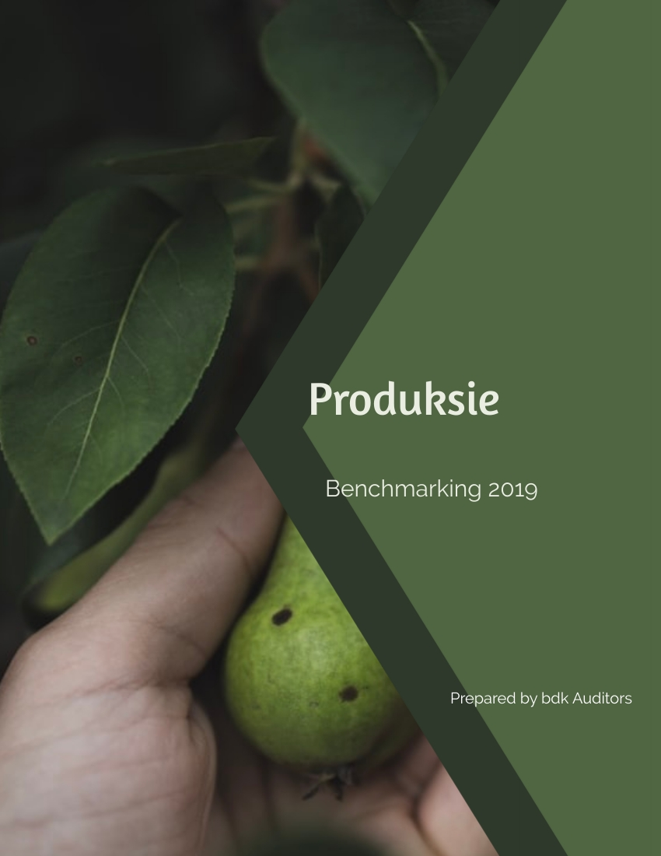

Slide 45
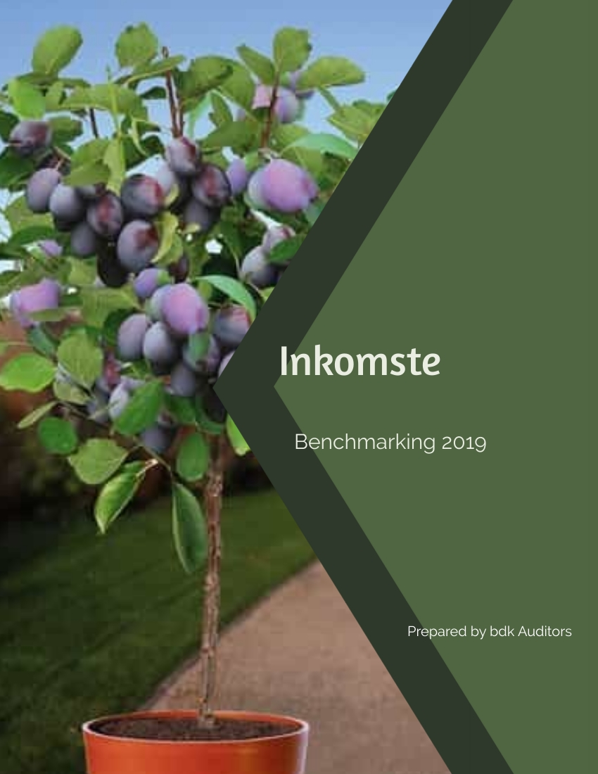
p.68

Slide 46
The profit of the Top 25% Producers
(Compared to the average farmer)
Income per ton
ALL APPLES
 |  |  |  |  |  |  |  |  | Top | % Difference
 | Av'11 | Av'12 | Av'13 | Av'14 | Av'15 | Av'16 | Av'17 | Av'18 | 25 % '18 | Av vs. 25%
 |  |  |  |  |  |  |  |  | *
Income per hectare | 118,516 | 157,205 | 239,404 | 227,599 | 239,380 | 241,113 | 231,005 | 271,055 | 332,053 | 23%
Comparison of income per ton
Average income per ton | 2,215 | 2,727 | 3,422 | 3,859 | 3,690 | 3,564 | 3,528 | 4,391 | 4,628 | 5%
Class 1 and class 2 income per ton | 3,034 | 3,508 | 4,590 | 5,163 | 4,958 | 5,038 | 5,175 | 6,353 | 6,448 | 1%
Total class 1 income per ton | 3,449 | 4,004 | 5,503 | 6,548 | 6,132 | 6,146 | 6,058 | 7,252 | 7,099 | -2%
Income analysis per class
Class 1 income per ton | 3,449 | 4,004 | 5,503 | 6,548 | 6,132 | 6,146 | 6,058 | 7,252 | 7,099 | -2%
Class 2 income per ton | 1,687 | 2,038 | 2,137 | 2,242 | 1,683 | 2,364 | 2,686 | 3,517 | 3,881
Class 2.5 income per ton | n/a | n/a | n/a | n/a | n/a | 1,644 | 1,397 | 2,026 | 1,990
Class 3 income per ton | 729 | 1,207 | 1,107 | 986 | 825 | 1,115 | 1,093 | 1,065 | 1,001
TON PER HECTARE APPLES PRODUCED
Class 1 ton per hectare | 26 | 28 | 34 | 28 | 33 | 30 | 28 | 29 | 37 | 30%
Class 2 ton per hectare | 8 | 10 | 13 | 13 | 12 | 12 | 10 | 9 | 9 | 4%
Class 2.5 ton per hectare | n/a | n/a | n/a | n/a | n/a | 3 | 7 | 7 | 7 | 11%
Class 3 ton per hectare | 19 | 20 | 23 | 18 | 20 | 23 | 20 | 17 | 18 | 3%
Class 1 & 2 per hectare | 34 | 38 | 46 | 41 | 45 | 42 | 39 | 38 | 46 | 23%
Total production per hectare | 54 | 58 | 70 | 59 | 65 | 68 | 65 | 62 | 72 | 16%
% Class 1 and class 2 of total | 63% | 66% | 66% | 69% | 69% | 62% | 59% | 61% | 65% | 6%
% Fruit in a box | n/a | n/a | n/a | n/a | n/a | 66% | 70% | 72% | 75% | 5%
Conclusion
1) Top 25% producers averages 72 tonnes/ha
2) Price per ton is 5% higher than average farmer.
3) Production is 16% higher.
4) Packouts class 1 & 2 is 6% higher.
*Top 25% All apple income per hectare and not top 25% profit
bdk auditors | Fruit Benchmarking survey 2019 10

Slide 47
The profit of the Top 25% Producers
(Compared to the average farmer)
Income per ton
GRANNY'S
 |  |  |  |  |  |  |  |  | Top | % Difference
 | Av'11 | Av'12 | Av'13 | Av'14 | Av'15 | Av'16 | Av'17 | Av'18 | 25 % '18 | Av vs. 25%
 |  |  |  |  |  |  |  |  | *
Income per hectare | 104,551 | 123,243 | 245,953 | 184,804 | 207,531 | 218,997 | 218,552 | 258,416 | 315,716 | 22%
Comparison of income per ton
Average income per ton | 1,876 | 2,403 | 3,230 | 3,588 | 3,162 | 2,934 | 3,365 | 4,110 | 4,525 | 10%
Class 1 and class 2 income per ton | 2,620 | 3,284 | 4,487 | 4,847 | 4,474 | 4,388 | 5,684 | 6,559 | 6,876 | 5%
Total class 1 income per ton | 3,050 | 3,806 | 5,709 | 6,186 | 5,964 | 5,713 | 6,862 | 7,838 | 7,781 | -1%
Income analysis per class
Class 1 income per ton | 3,050 | 3,806 | 5,709 | 6,186 | 5,964 | 5,713 | 6,862 | 7,838 | 7,781 | -1%
Class 2 income per ton | 1,146 | 1,801 | 1,446 | 1,668 | 1,174 | 2,013 | 2,530 | 2,678 | 3,315
Class 2.5 income per ton | n/a | n/a | n/a | n/a | n/a | 814 | 808 | 1,447 | 1,418
Class 3 income per ton | 744 | 1,196 | 1,260 | 939 | 885 | 1,096 | 1,002 | 1,132 | 1,037
TON PER HECTARE PRODUCED
Class 1 ton per hectare | 26 | 22 | 33 | 25 | 29 | 27 | 24 | 26 | 33 | 29%
Class 2 ton per hectare | 8 | 8 | 13 | 10 | 13 | 15 | 9 | 8 | 8 | -1%
Class 2.5 ton per hectare | n/a | n/a | n/a | n/a | n/a | 3 | 8 | 7 | 6 | -21%
Class 3 ton per hectare | 22 | 22 | 30 | 17 | 24 | 29 | 24 | 21 | 23 | 6%
Class 1 & 2 per hectare | 34 | 30 | 46 | 35 | 42 | 42 | 33 | 34 | 41 | 21%
Total production per hectare | 56 | 51 | 76 | 52 | 66 | 75 | 65 | 63 | 70 | 12%
% Class 1 and class 2 of total | 61% | 59% | 61% | 68% | 63% | 56% | 51% | 54% | 59% | 9%
% Fruit in a box | n/a | n/a | n/a | n/a | n/a | 61% | 63% | 66% | 68% | 2%
Conclusion
1) Price per ton is 10% higher than average farmer.
2) Production is 12% higher.
3) Packouts class 1 & 2 is 9% higher.
*(Note: Top 25% All Granny producers income per hectare and not top 25% profit)
bdk auditors | Fruit Benchmarking survey 2019 10

Slide 48
The profit of the Top 25% Producers
(Compared to the average farmer)
Income per ton
GOLDENS
 |  |  |  |  |  |  |  |  | Top | % Difference
 | Av'11 | Av'12 | Av'13 | Av'14 | Av'15 | Av'16 | Av'17 | Av'18 | 25 % '18 | Av vs. 25%
Income per hectare | 169,401 | 169,401 | 252,194 | 265,464 | 203,731 | 202,156 | 200,555 | 261,190 | 346,480 | 33%
Comparison of income per ton
Average income per ton | 2,355 | 2,355 | 3,137 | 3,601 | 2,787 | 2,639 | 2,586 | 3,597 | 4,215 | 17%
Class 1 and class 2 income per ton | 3,002 | 3,002 | 4,157 | 4,810 | 3,725 | 3,514 | 3,486 | 5,088 | 5,664 | 11%
Total class 1 income per ton | 3,300 | 3,300 | 4,732 | 6,168 | 4,684 | 4,099 | 3,910 | 5,719 | 6,590 | 15%
Income analysis per class
Class 1 income per ton | 3,300 | 3,300 | 4,732 | 6,168 | 4,684 | 4,099 | 3,910 | 5,719 | 6,590 | 15%
Class 2 income per ton | 2,132 | 2,132 | 2,548 | 2,405 | 1,469 | 2,203 | 2,645 | 3,711 | 3,690
Class 2.5 income per ton | n/a | n/a | n/a | n/a | n/a | 1,552 | 1,489 | 2,171 | 1,834
Class 3 income per ton | 1,185 | 1,185 | 1,045 | 957 | 727 | 1,005 | 1,087 | 1,049 | 930
TON PER HECTARE PRODUCED
Class 1 ton per hectare | 34 | 34 | 40 | 32 | 35 | 34 | 31 | 30 | 38 | 26%
Class 2 ton per hectare | 12 | 12 | 14 | 18 | 15 | 15 | 16 | 14 | 18 | 29%
Class 2.5 ton per hectare | 26 | 26 | 26 | 23 | 23 | 5 | 9 | 9 | 10 | 8%
Class 3 ton per hectare | n/a | n/a | n/a | n/a | n/a | 23 | 22 | 20 | 17 | -15%
Class 1 & 2 per hectare | 46 | 46 | 54 | 51 | 50 | 49 | 47 | 43 | 55 | 27%
Total production per hectare | 72 | 72 | 80 | 74 | 73 | 77 | 78 | 73 | 82 | 13%
% Class 1 and class 2 of total | 64% | 64% | 67% | 69% | 69% | 64% | 61% | 60% | 67% | 12%
% Fruit in a box | n/a | n/a | n/a | n/a | n/a | 70% | 72% | 72% | 79% | 10%
Conclusion
1) Price per ton is 17% higher than average farmer.
2) Production is 13% higher.
3) Packouts class 1 & 2 is 12% higher.
*(Note: Top 25% All Golden producers income per hectare and not top 25% profit)
bdk auditors | Fruit Benchmarking survey 2019 10

Slide 49
The profit of the Top 25% Producers
(Compared to the average farmer)
Income per ton
ROYAL GALAS
 |  |  |  |  |  |  |  |  | Top | % Difference
 | Av'11 | Av'12 | Av'13 | Av'14 | Av'15 | Av'16 | Av'17 | Av'18 | 25 % '18 | Av vs. 25%
 |  |  |  |  |  |  |  |  | *
Income per hectare | 97,128 | 156,804 | 221,330 | 203,122 | 203,731 | 278,156 | 300,077 | 297,032 | 384,766 | 30%
Comparison of income per ton
Average income per ton | 2,109 | 2,903 | 3,849 | 3,528 | 2,787 | 4,446 | 4,391 | 5,017 | 5,716 | 14%
Class 1 and class 2 income per ton | 2,857 | 3,424 | 4,737 | 4,902 | 3,725 | 5,886 | 5,782 | 6,611 | 7,133 | 8%
Total class 1 income per ton | 3,211 | 3,829 | 5,368 | 5,919 | 4,684 | 6,704 | 6,265 | 7,184 | 7,761 | 8%
Income analysis per class
Class 1 income per ton | 3,211 | 3,829 | 5,368 | 5,919 | 4,684 | 6,704 | 6,265 | 7,184 | 7,761 | 8%
Class 2 income per ton | 1,461 | 1,881 | 1,925 | 1,962 | 1,469 | 2,539 | 2,737 | 3,177 | 3,878
Class 2.5 income per ton | n/a | n/a | n/a | n/a | n/a | 2399 | 1328 | 1,860 | 2,255
Class 3 income per ton | 668 | 1,205 | 977 | 1,037 | 727 | 1,096 | 1,077 | 1,054 | 929
TON PER HECTARE PRODUCED
Class 1 ton per hectare | 24 | 33 | 36 | 28 | 35 | 35 | 41 | 36 | 43 | 20%
Class 2 ton per hectare | 6 | 9 | 8 | 10 | 15 | 9 | 7 | 6 | 8 | 39%
Class 2.5 ton per hectare | n/a | n/a | n/a | n/a | n/a | 1 | 6 | 5 | 4 | -8%
Class 3 ton per hectare | 16 | 13 | 14 | 20 | 23 | 18 | 15 | 13 | 12 | -8%
Class 1 & 2 per hectare | 30 | 41 | 44 | 37 | 50 | 43 | 48 | 42 | 51 | 23%
Total production per hectare | 46 | 54 | 57 | 58 | 73 | 63 | 68 | 59 | 67 | 14%
% Class 1 and class 2 of total | 65% | 76% | 76% | 64% | 69% | 69% | 70% | 70% | 76% | 8%
% Fruit in a box | n/a | n/a | n/a | n/a | n/a | 71% | 78% | 78% | 82% | 5%
% Old strain of total bearing hectares | n/a | n/a | n/a | n/a | n/a | n/a | n/a | 73% | 61% | -17%
% New strain of total bearing hectares | n/a | n/a | n/a | n/a | n/a | n/a | n/a | 27% | 39% | 47%
Conclusion
1) Price per ton is 14% higher than average farmer.
2) Production is 14% higher.
3) Packouts class 1 & 2 is 8% higher.
bdk auditors | Fruit Benchmarking survey 2019 10

Slide 50
PINK LADIES
 |  |  |  |  |  |  |  |  | Top | % Difference
 | Av'11 | Av'12 | Av'13 | Av'14 | Av'15 | Av'16 | Av'17 | Av'18 | 25 % 18 | Av vs. 25%
 |  |  |  |  |  |  |  |  | *
Income per hectare | 163,382 | 191,301 | 307,232 | 294,827 | 361,048 | 313,692 | 300,439 | 346,325 | 487,266 | 41%
Comparison of income per ton
Average income per ton | 2,593 | 3,353 | 3,752 | 4,574 | 5,104 | 4,123 | 4,364 | 5,077 | 5,791 | 14%
Class 1 and class 2 income per ton | 3,827 | 4,577 | 5,397 | 5,878 | 6,746 | 6,345 | 6,884 | 7,708 | 8,068 | 5%
Total class 1 income per ton | 4,508 | 5,608 | 7,121 | 8,096 | 8,677 | 7,722 | 8,645 | 8,895 | 9,060 | 2%
Income analysis per class
Class 1 income per ton | 4,508 | 5,608 | 7,121 | 8,096 | 8,677 | 7,722 | 8,645 | 8,895 | 9,060 | 2%
Class 2 income per ton | 1,880 | 2,213 | 1,803 | 1,983 | 1,867 | 2,764 | 1,932 | 3,402 | 3,598
Class 2.5 income per ton | n/a | n/a | n/a | n/a | n/a | 2,234 | 1,497 | 2,046 | 2,095
Class 3 income per ton | 741 | 1,096 | 1,147 | 1,049 | 906 | 1,296 | 1,401 | 1,094 | 1,113
TON PER HECTARE PRODUCED
Class 1 ton per hectare | 28 | 26 | 34 | 30 | 36 | 30 | 27 | 31 | 45 | 45%
Class 2 ton per hectare | 10 | 11 | 16 | 17 | 14 | 12 | 10 | 9 | 10 | 17%
Class 2.5 ton per hectare | n/a | n/a | n/a | n/a | n/a | 3 | 8 | 9 | 10 | 14%
Class 3 ton per hectare | 25 | 20 | 32 | 17 | 20 | 31 | 23 | 19 | 19 | -4%
Class 1 & 2 per hectare | 38 | 37 | 50 | 47 | 51 | 42 | 37 | 40 | 55 | 39%
Total production per hectare | 63 | 57 | 82 | 64 | 71 | 76 | 69 | 68 | 84 | 23%
% Class 1 and class 2 of total | 60% | 65% | 61% | 73% | 72% | 55% | 54% | 58% | 66% | 12%
% Fruit in a box | n/a | n/a | n/a | n/a | n/a | 59% | 66% | 72% | 78% | 9%
% Old strain of total bearing hectares | n/a | n/a | n/a | n/a | n/a | n/a | n/a | 53% | 55% | 3%
% New strain of total bearing hectares | n/a | n/a | n/a | n/a | n/a | n/a | n/a | 47% | 45% | -3%
bdk auditors | Fruit Benchmarking survey 2019 10

Slide 51
The profit of the Top 25% Producers
(Compared to the average farmer)
Income per ton
PACKHAMS
 |  |  |  |  |  |  |  |  |  | Top
 | Av'11 | Av'12 | Av'13 | Av'14 | Av'15 | Av'16 | Av'17 | Av'18 | 25 % 18 | Av vs. 25%
 |  |  |  |  |  |  |  |  | *
Income per hectare | 112,078 | 134,395 | 208,079 | 205,613 | 211,001 | 259,393 | 268,439 | 234,092 | 325,021 | 39%
Comparison of income per ton
Average income per ton | 2,179 | 2,285 | 3,863 | 3,843 | 3,870 | 4,943 | 4,261 | 4,404 | 4,640 | 5%
Class 1 and class 2 income per ton | 2,743 | 2,824 | 4,774 | 4,693 | 4,906 | 6,271 | 5,658 | 6,054 | 6,215 | 3%
Total class 1 income per ton | 3,077 | 3,274 | 5,620 | 5,329 | 5,502 | 7,342 | 6,235 | 6,710 | 6,859 | 2%
Income analysis per class
Class 1 income per ton | 3,077 | 3,274 | 5,620 | 5,329 | 5,502 | 7,342 | 6,235 | 6,710 | 6,859 | 2%
Class 2 income per ton | 1,833 | 1,717 | 2,656 | 2,170 | 2,205 | 3,295 | 3,614 | 3,582 | 3,701
Class 2.5 income per ton | n/a | n/a | n/a | n/a | n/a | 2,189 | 2,294 | 2,117 | 2,040
Class 3 income per ton | 538 | 694 | 852 | 1,019 | 556 | 1,022 | 941 | 855 | 813
TON PER HECTARE PRODUCED
Class 1 ton per hectare | 28 | 31 | 30 | 33 | 34 | 29 | 33 | 27 | 38 | 40%
Class 2 ton per hectare | 10 | 13 | 12 | 8 | 8 | 10 | 9 | 7 | 10 | 35%
Class 2.5 ton per hectare | n/a | n/a | n/a | n/a | n/a | 1 | 6 | 9 | 11 | 16%
Class 3 ton per hectare | 13 | 15 | 13 | 12 | 13 | 12 | 14 | 10 | 12 | 23%
Class 1 & 2 per hectare | 38 | 44 | 41 | 41 | 42 | 39 | 43 | 34 | 47 | 39%
Total production per hectare | 51 | 59 | 54 | 54 | 55 | 52 | 63 | 53 | 70 | 32%
% Class 1 and class 2 of total | 75% | 75% | 77% | 77% | 76% | 74% | 68% | 64% | 67% | 5%
% Fruit in a box | n/a | n/a | n/a | n/a | n/a | 77% | 77% | 82% | 83% | 1%
Conclusion
1) Price per ton is 2% higher than average farmer.
2) Production is 32% higher.
3) Packouts class 1 & 2 is 5% higher.
*(Note: Top 25% All Packhams producers income per hectare and not top 25% profit)
bdk auditors | Fruit Benchmarking survey 2019 10

Slide 52
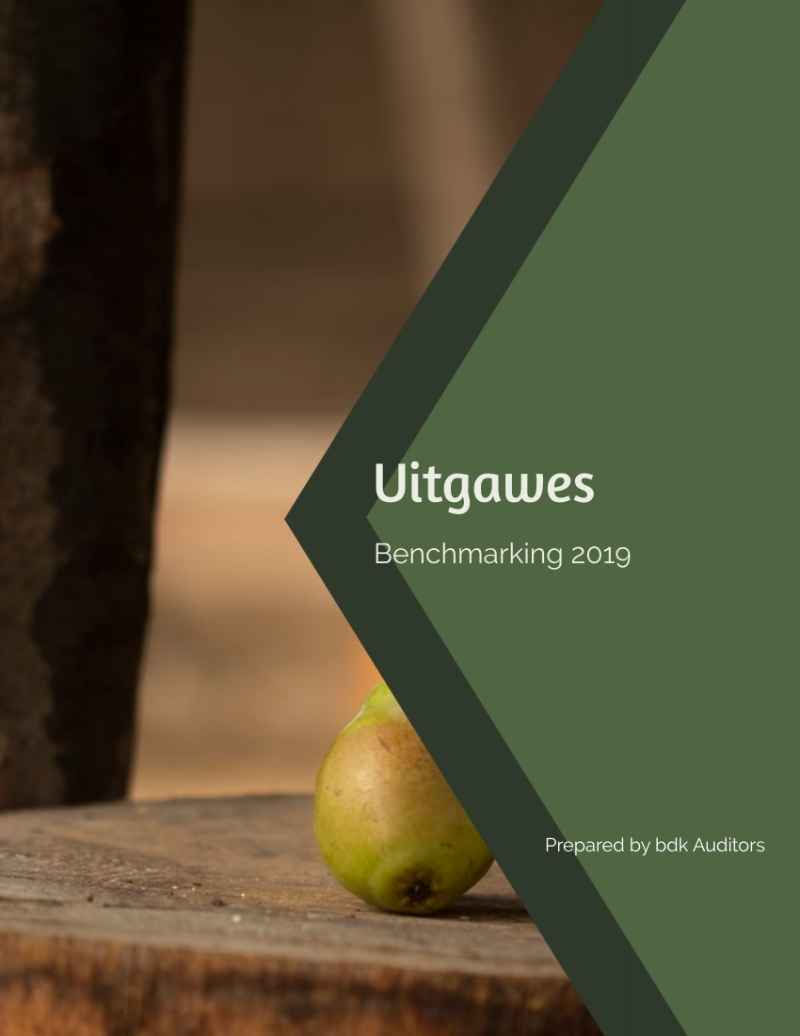
p.74

Slide 53
SPESIFIEKE KOSTE ONTLEDING PER TON GEPRODUSEER 2018/2019 JAAR
 | Arbeidskoste per ton prod | Arbeidskoste per prod/ha | Arbeidskoste as % van lopende uitgawes | Arbeidskoste as % van inkomste | Winsdeel per prod/ha ingsl. By arbeidskoste | Produksielone permanent per prod ha | % permanente loon van totaal | Produksielone tydelik per prod ha | % tydelike loon van totaal | Salarisse per prod ha | % salaris van totaal | Wins per produserende ha | ETI per produserende ha geëis
Gem'18 | 1,421 | 76,935 | 48% | 32% | 1,826 | 36,937 | 48% | 19,504 | 25% | 20,356 | 26% | 75,795 | 4,400
Gem'17 | 1,262 | 72,654 | 49% | 34% | 2,016 | 36,811 | 51% | 15,903 | 22% | 18,666 | 26% | 62,392 | 3,182
Beste 25 % '18** | 1,223 | 76,653 | 48% | 27% | 2,819 | 39,321 | 51% | 17,097 | 22% | 20,146 | 26% | 126,712 | 4,718
Beste 25 % '17** | 1,006 | 65,533 | 48% | 26% | 3,669 | 26,262 | 40% | 21,088 | 32% | 19,357 | 30% | 117,372 | 2,656
9 | 741 | 43,534 | 33% | 16% | 0 | 13,071 | 30% | 16,773 | 39% | 10,504 | 24% | 136,075 | 0
49 | 871 | 74,972 | 43% | 21% | 2,516 | 26,727 | 36% | 30,468 | 41% | 12,818 | 17% | 183,739 | 0
23 | 911 | 42,700 | 39% | 29% | 0 | 9,152 | 21% | 21,482 | 50% | 11,774 | 28% | 39,450 | 0
59 | 921 | 68,383 | 41% | 20% | 0 | 68,494 | 100% | 0 | 0% | 15,382 | 22% | 169,148 | 27,701
51 | 923 | 64,521 | 38% | 21% | 2,622 | 22,385 | 35% | 23,607 | 37% | 13,359 | 21% | 142,291 | 0
28 | 937 | 60,190 | 43% | 19% | 7,910 | 20,352 | 34% | 23,109 | 38% | 23,656 | 39% | 179,426 | 2,336
50 | 982 | 56,619 | 35% | 21% | 2,702 | 19,103 | 34% | 18,420 | 33% | 13,768 | 24% | 110,953 | 0
37 | 1,004 | 61,808 | 0 | 0 | 0 | 23,382 | 38% | 23,036 | 37% | 14,123 | 23% | 90,422 | 1,440
24 | 1,004 | 58,761 | 44% | 22% | 7,732 | 15,960 | 27% | 29,410 | 50% | 20,083 | 34% | 132,114 | 2,261
27 | 1,018 | 57,537 | 47% | 26% | 7,334 | 18,725 | 33% | 27,609 | 48% | 17,384 | 30% | 103,385 | 2,082
61 | 1,046 | 64,791 | 41% | 24% | 0 | 65,104 | 100% | 0 | 0% | 14,066 | 22% | 114,113 | 26,543
32 | 1,070 | 67,188 | 44% | 18% | 6,647 | 16,133 | 24% | 26,552 | 40% | 32,310 | 48% | 213,126 | 3,343
34 | 1,070 | 67,188 | 44% | 20% | 6,647 | 16,133 | 24% | 26,552 | 40% | 32,310 | 48% | 184,398 | 3,343
2 | 1,119 | 62,374 | 43% | 23% | 0 | 12,136 | 19% | 22,537 | 36% | 28,128 | 45% | 125,675 | 2,687
21 | 1,120 | 81,452 | 51% | 30% | 0 | 19,167 | 24% | 25,284 | 31% | 25,335 | 31% | 109,039 | 5,163
63 | 1,140 | 64,066 | 48% | 31% | 688 | 18,835 | 29% | 25,035 | 39% | 17,204 | 27% | 70,196 | 628
36 | 1,211 | 66,446 | 50% | 31% | 1,262 | 15,727 | 24% | 29,031 | 44% | 20,625 | 31% | 77,177 | 216
60 | 1,214 | 61,487 | 42% | 30% | 0 | 61,985 | 101% | 0 | 0% | 12,856 | 21% | 63,488 | 25,478
40 | 1,225 | 70,869 | 49% | 36% | 1,277 | 29,843 | 42% | 14,891 | 21% | 15,090 | 21% | 49,442 | 0
31 | 1,226 | 58,854 | 44% | 29% | 6,536 | 17,155 | 29% | 27,404 | 47% | 19,544 | 33% | 71,494 | 2,358
35 | 1,226 | 61,411 | 37% | 27% | 0 | 28,762 | 47% | 14,221 | 23% | 13,115 | 21% | 61,184 | 1,723
25 | 1,229 | 61,104 | 46% | 28% | 6,558 | 18,926 | 31% | 27,908 | 46% | 19,355 | 32% | 89,721 | 2,243
55 | 1,281 | 74,866 | 54% | 30% | 5,594 | 20,520 | 27% | 32,468 | 43% | 24,093 | 32% | 113,609 | 2,165
39 | 1,282 | 62,325 | 41% | 28% | 4,393 | 9,681 | 16% | 34,694 | 56% | 22,791 | 37% | 70,747 | 4,138
42 | 1,282 | 62,325 | 41% | 30% | 4,393 | 9,681 | 16% | 34,694 | 56% | 22,791 | 37% | 52,840 | 4,138
22 | 1,350 | 75,366 | 51% | 37% | 0 | 18,658 | 25% | 19,285 | 26% | 25,176 | 33% | 54,715 | 3,493
30 | 1,352 | 55,373 | 41% | 42% | 3,567 | 14,571 | 26% | 26,401 | 48% | 16,226 | 29% | -987 | 2,286
7 | 1,357 | 95,614 | 45% | 39% | 0 | 14,220 | 15% | 49,090 | 51% | 21,941 | 23% | 35,408 | 0
bdk auditors | Fruit Benchmarking survey 2019 10

Slide 54
SPESIFIEKE KOSTE ONTLEDING PER TON GEPRODUSEER 2018/2019 JAAR
 | Arbeidskoste per ton prod | Arbeidskoste per prod/ha | Arbeidskoste as % van lopende uitgawes | Arbeidskoste as % van inkomste | Winsdeel per prod/ha ingsl. By arbeidskoste | Produksielone permanent per prod ha | % permanente loon van totaal | Produksielone tydelik per prod ha | % tydelike loon van totaal | Salarisse per prod ha | % salaris van totaal | Wins per produserende ha | ETI per produserende ha geëis
Gem'18 | 1,421 | 76,935 | 48% | 32% | 1,826 | 36,937 | 48% | 19,504 | 25% | 20,356 | 26% | 75,795 | 4,400
Gem'17 | 1,262 | 72,654 | 49% | 34% | 2,016 | 36,811 | 51% | 15,903 | 22% | 18,666 | 26% | 62,392 | 3,182
Beste 25 % '18** | 1,223 | 76,653 | 48% | 27% | 2,819 | 39,321 | 51% | 17,097 | 22% | 20,146 | 26% | 126,712 | 4,718
Beste 25 % '17** | 1,006 | 65,533 | 48% | 26% | 3,669 | 26,262 | 40% | 21,088 | 32% | 19,357 | 30% | 117,372 | 2,656
7 | 1,357 | 95,614 | 45% | 39% | 0 | 14,220 | 15% | 49,090 | 51% | 21,941 | 23% | 35,408 | 0
57 | 1,378 | 88,568 | 48% | 31% | 0 | 47,228 | 53% | 8,971 | 10% | 25,132 | 28% | 103,348 | 0
3 | 1,380 | 77,777 | 45% | 30% | 0 | 16,905 | 22% | 27,063 | 35% | 35,278 | 45% | 83,349 | 3,708
62 | 1,393 | 70,970 | 48% | 32% | 2,888 | 26,356 | 37% | 22,956 | 32% | 20,737 | 29% | 75,559 | 1,718
Gemiddelde
13 | 1,429 | 70,153 | 52% | 29% | 0 | 44,171 | 63% | 1,244 | 2% | 19,681 | 28% | 109,213 | 1,208
11 | 1,449 | 87,550 | 43% | 44% | 4,711 | 40,075 | 46% | 49,085 | 56% | 21,952 | 25% | -5,516 | 23,242
33 | 1,451 | 75,926 | 45% | 28% | 0 | 31,632 | 42% | 21,035 | 28% | 16,277 | 21% | 101,384 | 0
10 | 1,469 | 70,816 | 42% | 33% | 0 | 22,966 | 32% | 29,470 | 42% | 13,070 | 18% | 46,620 | 0
4 | 1,482 | 72,543 | 44% | 31% | 0 | 6,462 | 9% | 40,659 | 56% | 24,286 | 33% | 72,427 | 0
52 | 1,493 | 71,092 | 47% | 26% | 3,355 | 51,521 | 72% | 0 | 0% | 18,990 | 27% | 118,936 | 3,398
53 | 1,493 | 71,092 | 47% | 29% | 3,355 | 51,521 | 72% | 0 | 0% | 18,990 | 27% | 97,840 | 3,398
46 | 1,521 | 95,043 | 52% | 33% | 0 | 66,405 | 70% | 5,860 | 6% | 16,076 | 17% | 102,241 | 4,183
26 | 1,524 | 59,404 | 45% | 32% | 7,681 | 16,631 | 28% | 28,230 | 48% | 20,469 | 34% | 50,614 | 2,377
16 | 1,525 | 65,196 | 44% | 31% | 0 | 36,386 | 56% | 9,368 | 14% | 17,787 | 27% | 63,507 | 2,871
38 | 1,533 | 72,247 | 47% | 41% | 0 | 39,052 | 54% | 18,119 | 25% | 11,350 | 16% | 21,635 | 1,841
1 | 1,546 | 87,769 | 46% | 35% | 0 | 19,999 | 23% | 29,999 | 34% | 39,917 | 45% | 55,889 | 4,370
43 | 1,583 | 93,322 | 59% | 43% | 0 | 28,212 | 30% | 40,354 | 43% | 22,447 | 24% | 59,513 | 6,076
12 | 1,607 | 74,431 | 51% | 60% | 0 | 12,832 | 17% | 48,542 | 65% | 15,806 | 21% | -23,503 | 7,421
6 | 1,694 | 84,634 | 63% | 41% | 0 | 75,369 | 89% | 0 | 0% | 0 | 0% | 69,754 | 575
19 | 1,697 | 75,144 | 47% | 36% | 0 | 23,053 | 31% | 38,506 | 51% | 11,802 | 16% | 49,559 | 687
8 | 1,712 | 77,864 | 44% | 38% | 0 | 25,522 | 33% | 32,751 | 42% | 13,733 | 18% | 23,509 | 0
58 | 1,763 | 98,760 | 51% | 40% | 0 | 51,466 | 52% | 15,945 | 16% | 22,221 | 23% | 52,605 | 0
41 | 1,791 | 87,198 | 51% | 45% | 0 | 0 | 0% | 38,491 | 44% | 45,409 | 52% | 22,418 | 0
48 | 1,792 | 93,109 | 51% | 39% | 0 | 64,072 | 69% | 5,195 | 6% | 19,411 | 21% | 57,168 | 4,365
44 | 1,808 | 90,673 | 48% | 38% | 0 | 65,590 | 72% | 3,893 | 4% | 17,368 | 19% | 53,051 | 4,269
20 | 1,903 | 68,144 | 50% | 54% | 0 | 18,054 | 26% | 12,164 | 18% | 24,988 | 37% | -9,759 | 1,510
bdk auditors | Fruit Benchmarking survey 2019 10

Slide 55
SPESIFIEKE KOSTE ONTLEDING PER TON GEPRODUSEER 2018/2019 JAAR
 | Arbeidskoste per ton prod | Arbeidskoste per prod/ha | Arbeidskoste as % van lopende uitgawes | Arbeidskoste as % van inkomste | Winsdeel per prod/ha ingsl. By arbeidskoste | Produksielone permanent per prod ha | % permanente loon van totaal | Produksielone tydelik per prod ha | % tydelike loon van totaal | Salarisse per prod ha | % salaris van totaal | Wins per produserende ha | ETI per produserende ha geëis
Gem'18 | 1,421 | 76,935 | 48% | 32% | 1,826 | 36,937 | 48% | 19,504 | 25% | 20,356 | 26% | 75,795 | 4,400
Gem'17 | 1,262 | 72,654 | 49% | 34% | 2,016 | 36,811 | 51% | 15,903 | 22% | 18,666 | 26% | 62,392 | 3,182
Beste 25 % '18** | 1,223 | 76,653 | 48% | 27% | 2,819 | 39,321 | 51% | 17,097 | 22% | 20,146 | 26% | 126,712 | 4,718
Beste 25 % '17** | 1,006 | 65,533 | 48% | 26% | 3,669 | 26,262 | 40% | 21,088 | 32% | 19,357 | 30% | 117,372 | 2,656
5 | 1,920 | 83,039 | 38% | 46% | 0 | 61,264 | 74% | 4,894 | 6% | 9,409 | 11% | -39,189 | 579
18 | 1,920 | 84,903 | 51% | 38% | 0 | 52,482 | 62% | 4,937 | 6% | 22,482 | 26% | 56,570 | 1,819
45 | 1,953 | 94,108 | 54% | 44% | 0 | 60,418 | 64% | 6,119 | 7% | 24,718 | 26% | 39,469 | 4,533
29 | 1,981 | 62,704 | 48% | 45% | 8,593 | 19,455 | 31% | 26,310 | 42% | 25,658 | 41% | 8,402 | 3,303
54 | 2,062 | 97,599 | 51% | 43% | 1,041 | 34,991 | 36% | 29,442 | 30% | 28,370 | 29% | 34,213 | 2,938
15 | 2,104 | 93,675 | 57% | 38% | 0 | 57,578 | 61% | 6,481 | 7% | 22,795 | 24% | 79,452 | 1,597
56 | 2,237 | 108,195 | 54% | 53% | 0 | 55,390 | 51% | 22,401 | 21% | 19,527 | 18% | 5,629 | 0
14 | 2,445 | 128,221 | 55% | 53% | 0 | 83,145 | 65% | 34 | 0% | 37,694 | 29% | 8,928 | 1,330
17 | 4,035 | 117,019 | 50% | 112% | 0 | 79,827 | 68% | 0 | 0% | 30,141 | 26% | -129,315 | 1,327
47 | 4,342 | 90,060 | 50% | 96% | 0 | 61,248 | 68% | 3,691 | 4% | 22,320 | 25% | -87,425 | 5,055
* = Akkuraatheid verdag |  |  |  |  |  | * |  | * |  | *
**Beste 25% wins per produserende hektaar
bdk auditors | Fruit Benchmarking survey 2019 10

Slide 56
SPESIFIEKE KOSTE ONTLEDING VIR OESBESKERMING & KUNSMIS PER TON GEPRODUSEER
 | Spuitstowwe en kunsmis per ton | Spuitstowwe en kunsmis per ha |  | Profit per producing hectare
Gem'18 | 543 | 29,419 |  | 77,351
Gem'17 | 481 | 27,693 |  | 62,392
Beste 25 % '18* | 457 | 28,650 |  | 126,712
Beste 25 % '17* | 359 | 24,494 |  | 117,372
6 | 303 | 15,161 |  | 69,754
27 | 343 | 19,418 |  | 103,385
11 | 347 | 20,945 |  | 40,968
55 | 377 | 22,014 |  | 113,609
49 | 381 | 32,796 |  | 183,739
28 | 407 | 26,167 |  | 179,426
37 | 409 | 25,175 |  | 90,422
25 | 427 | 21,258 |  | 89,721
24 | 434 | 25,396 |  | 132,114
2 | 444 | 24,716 |  | 125,675
46 | 449 | 28,071 |  | 102,241
21 | 449 | 32,679 |  | 109,039
59 | 452 | 33,559 |  | 169,148
33 | 462 | 24,194 |  | 101,384
7 | 463 | 32,622 |  | 35,408
40 | 476 | 27,546 |  | 49,442
63 | 477 | 26,821 |  | 70,196
43 | 481 | 28,377 |  | 59,513
36 | 482 | 26,462 |  | 77,177
26 | 483 | 18,827 |  | 50,614
bdk auditors | Fruit Benchmarking survey 2019 10

Slide 57
SPESIFIEKE KOSTE ONTLEDING VIR OESBESKERMING & KUNSMIS PER TON GEPRODUSEER
 | Spuitstowwe en kunsmis per ton | Spuitstowwe en kunsmis per ha |  | Profit per producing hectare
51 | 489 | 34,181 |  | 142,291
32 | 506 | 31,792 |  | 213,126
34 | 506 | 31,792 |  | 184,398
3 | 519 | 29,250 |  | 83,349
31 | 521 | 25,009 |  | 71,494
9 | 527 | 30,973 |  | 136,075
22 | 533 | 29,782 |  | 54,715
Gemiddelde
29 | 549 | 17,390 |  | 8,402
13 | 552 | 27,080 |  | 109,213
61 | 566 | 35,046 |  | 114,113
62 | 567 | 28,868 |  | 75,559
1 | 567 | 32,192 |  | 55,889
52 | 570 | 27,155 |  | 118,936
53 | 570 | 27,155 |  | 97,840
48 | 572 | 29,725 |  | 57,168
39 | 591 | 28,741 |  | 70,747
42 | 591 | 28,741 |  | 52,840
23 | 591 | 27,726 |  | 39,450
19 | 592 | 26,210 |  | 49,559
41 | 601 | 29,276 |  | 22,418
45 | 606 | 29,211 |  | 39,469
50 | 611 | 35,228 |  | 110,953
38 | 630 | 29,664 |  | 21,635
44 | 636 | 31,892 |  | 53,051
bdk auditors | Fruit Benchmarking survey 2019 10

Slide 58
SPESIFIEKE KOSTE ONTLEDING VIR OESBESKERMING & KUNSMIS PER TON GEPRODUSEER
 | Spuitstowwe en kunsmis per ton | Spuitstowwe en kunsmis per ha |  | Profit per producing hectare
12 | 639 | 29,589 |  | -23,503
15 | 680 | 30,263 |  | 79,452
60 | 719 | 36,414 |  | 63,488
10 | 726 | 34,982 |  | 46,620
4 | 729 | 35,690 |  | 72,427
18 | 735 | 32,502 |  | 56,570
20 | 736 | 26,343 |  | -9,759
16 | 755 | 32,271 |  | 63,507
8 | 792 | 36,018 |  | 23,509
56 | 803 | 38,819 |  | 5,629
58 | 811 | 45,450 |  | 52,605
57 | 819 | 52,613 |  | 103,348
14 | 862 | 45,215 |  | 8,928
30 | 867 | 35,506 |  | -987
5 | 892 | 38,566 |  | -39,189
35 | 893 | 44,730 |  | 61,184
54 | 900 | 42,606 |  | 34,213
47 | 1,453 | 30,141 |  | -87,425
17 | 1,504 | 43,628 |  | -129,315
* Beste 25% wins per produserende hektaar
bdk auditors | Fruit Benchmarking survey 2019 10

Slide 59
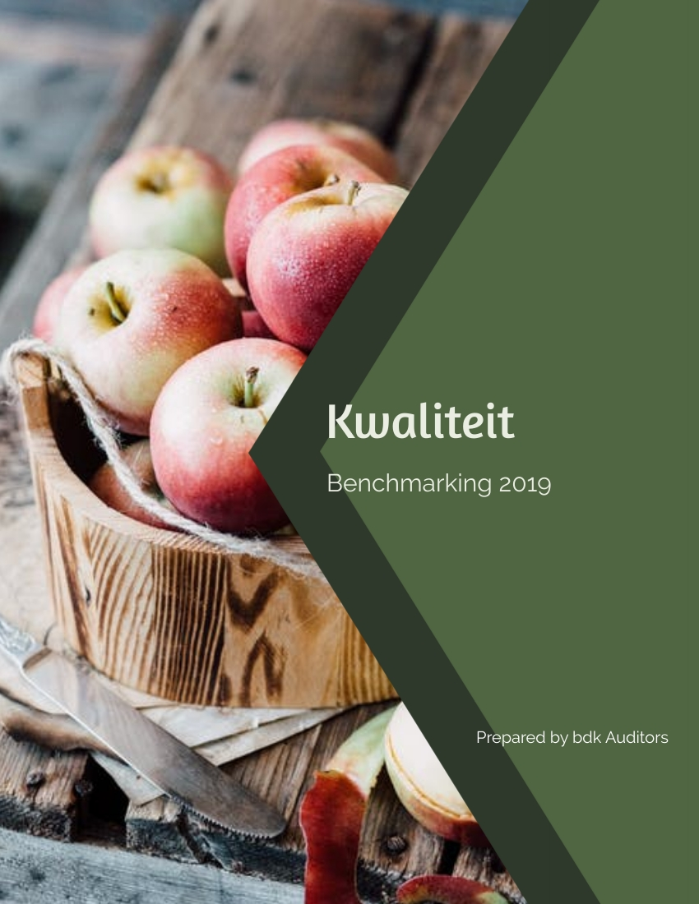
p.88

Slide 60
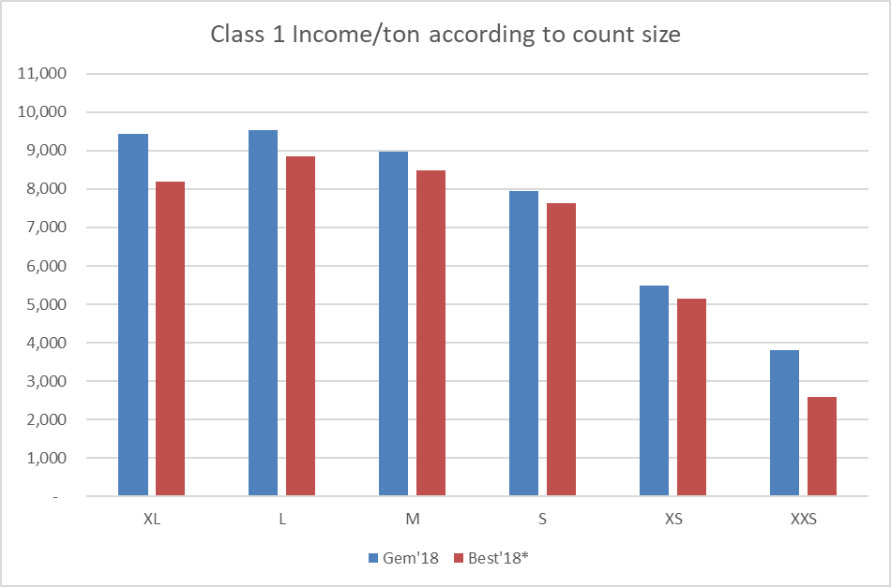
INCOME FOR GRANNYS ON
CLASS 1 TONS 2018/2019 YEAR
bdk auditors | Fruit Benchmarking survey 2019 10

Slide 61
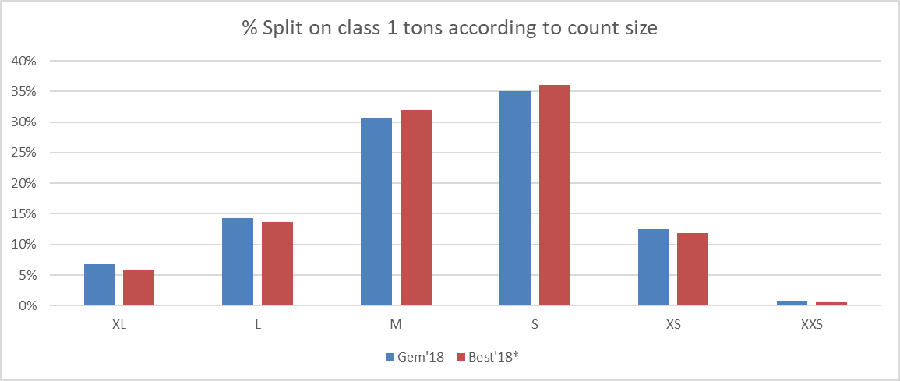
bdk auditors | Fruit Benchmarking survey 2019 10

Slide 62
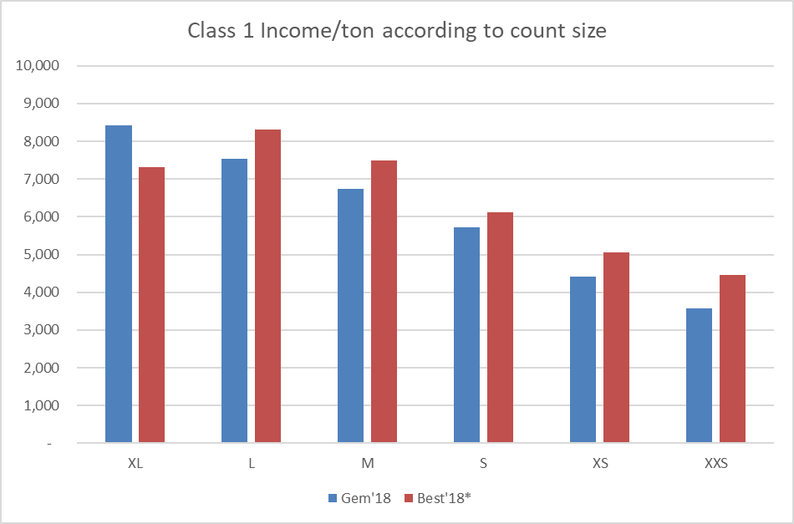
INCOME FOR GOLDENS ON
CLASS 1 TONS 2018/2019 YEAR
bdk auditors | Fruit Benchmarking survey 2019 10

Slide 63
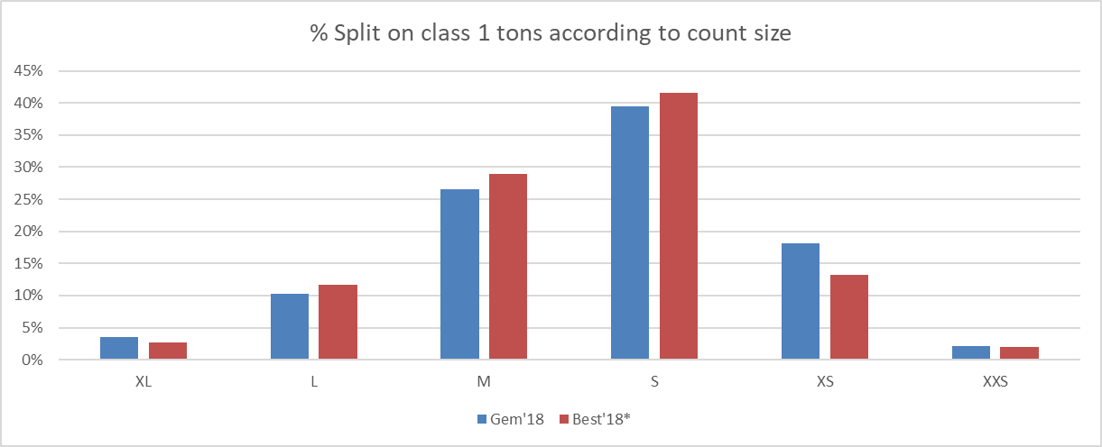
bdk auditors | Fruit Benchmarking survey 2019 10

Slide 64
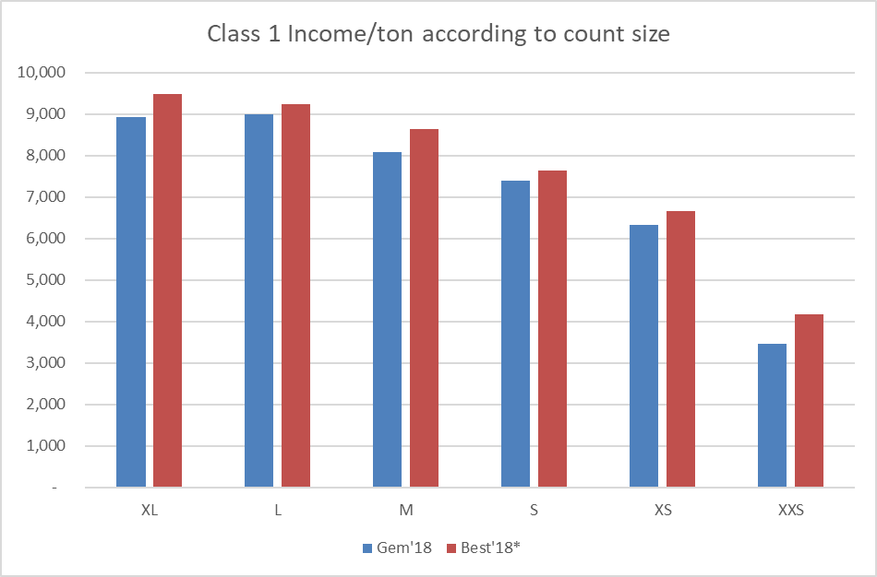
INCOME FOR GALAS ON
CLASS 1 TONS 2018/2019 YEAR
bdk auditors | Fruit Benchmarking survey 2019 10

Slide 65
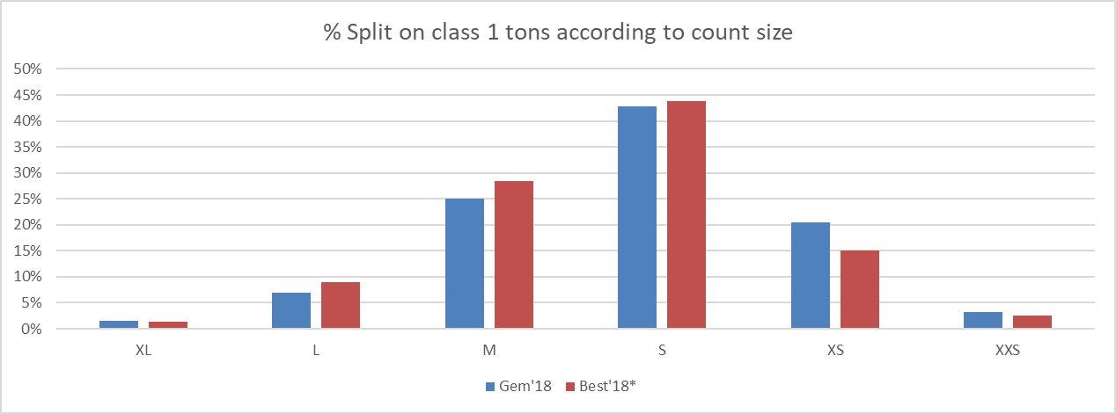
bdk auditors | Fruit Benchmarking survey 2019 10

Slide 66
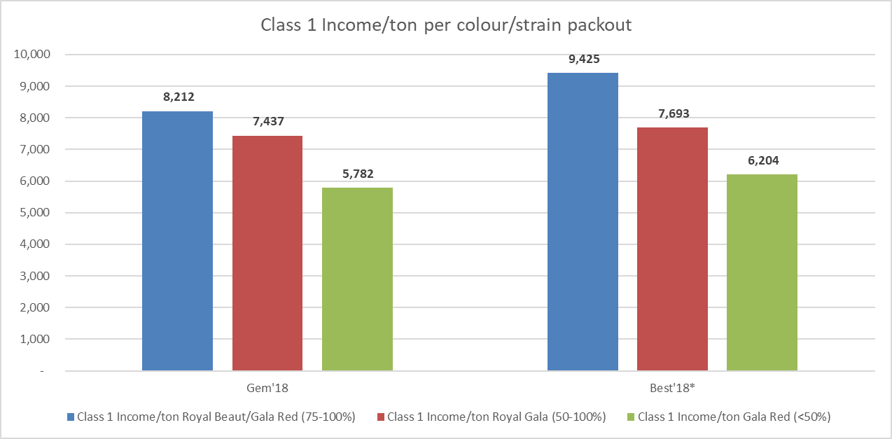
bdk auditors | Fruit Benchmarking survey 2019 10

Slide 67
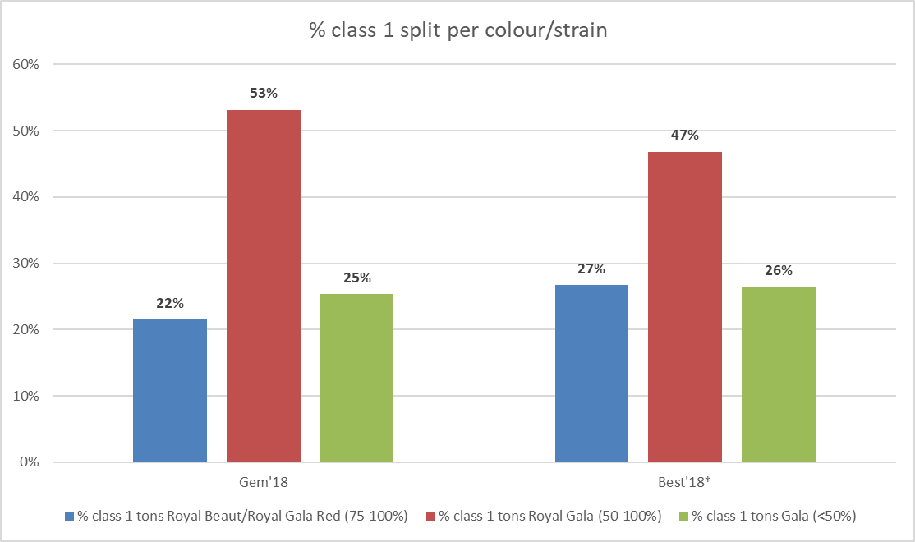
bdk auditors | Fruit Benchmarking survey 2019 10

Slide 68
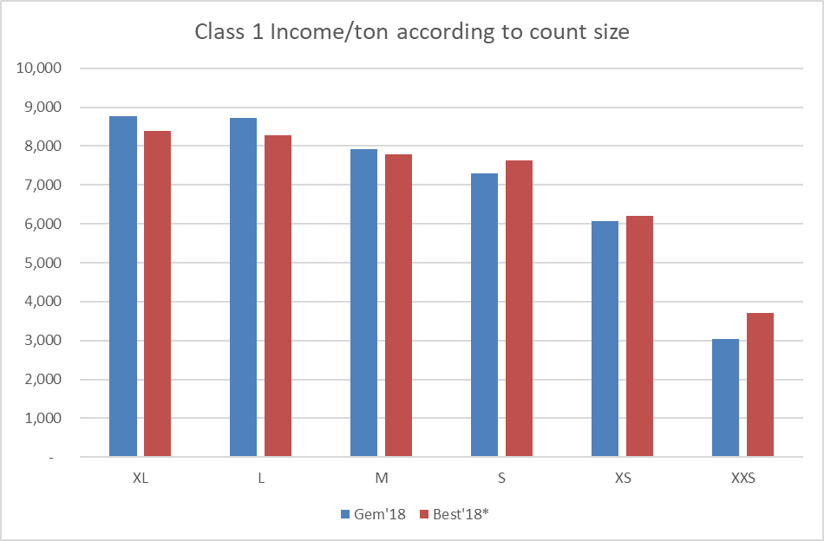
INCOME FOR FUJI ON
CLASS 1 TONS 2018/2019 YEAR
bdk auditors | Fruit Benchmarking survey 2019 10

Slide 69
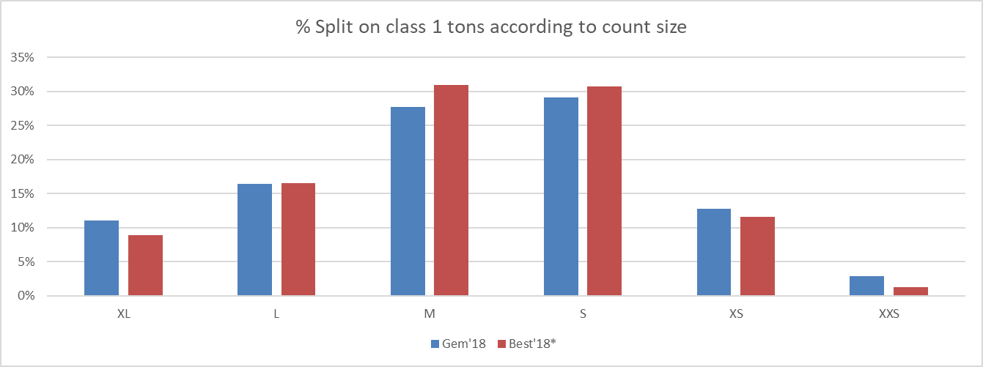
bdk auditors | Fruit Benchmarking survey 2019 10

Slide 70
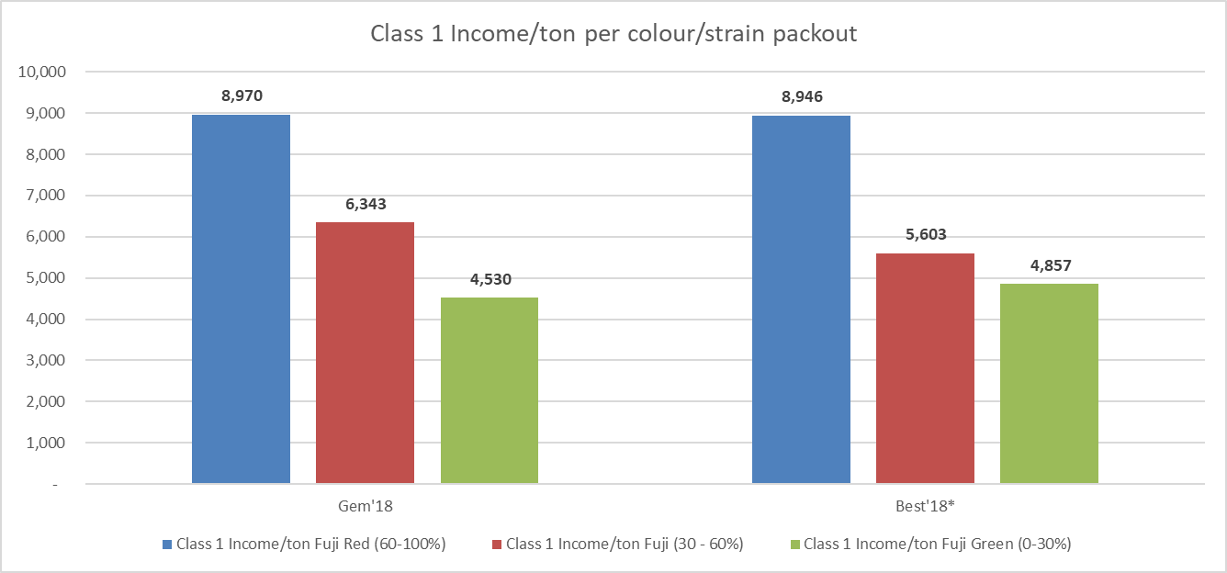
bdk auditors | Fruit Benchmarking survey 2019 10

Slide 71
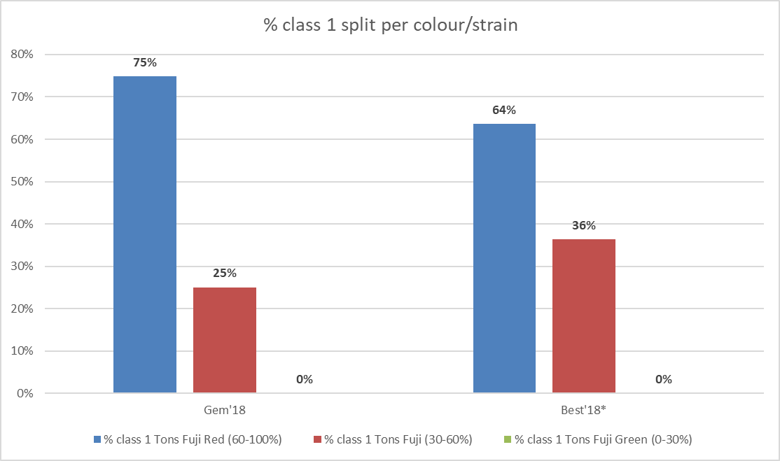
bdk auditors | Fruit Benchmarking survey 2019 10

Slide 72
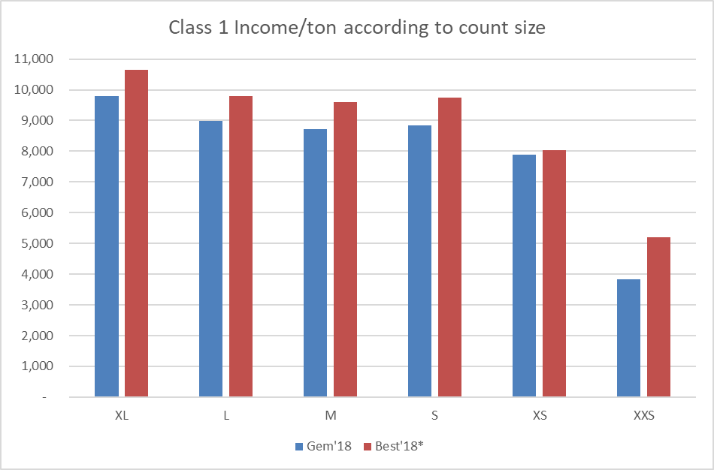
INCOME FOR PINK LADIES ON
CLASS 1 TONS 2018/2019 YEAR
bdk auditors | Fruit Benchmarking survey 2019 10

Slide 73
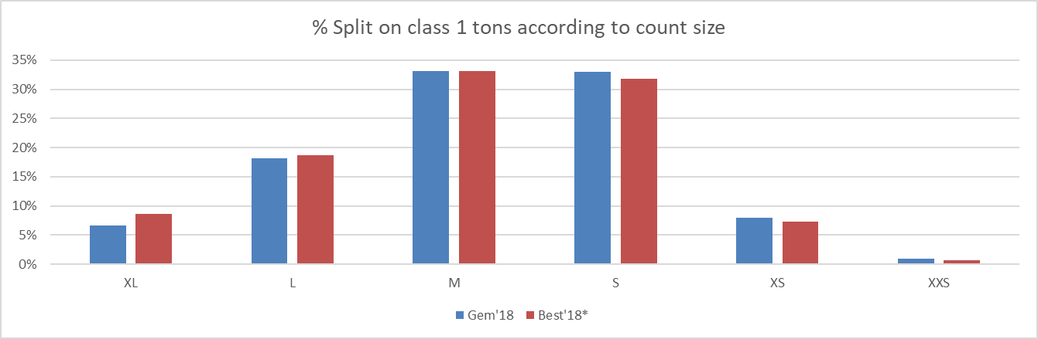
bdk auditors | Fruit Benchmarking survey 2019 10

Slide 74
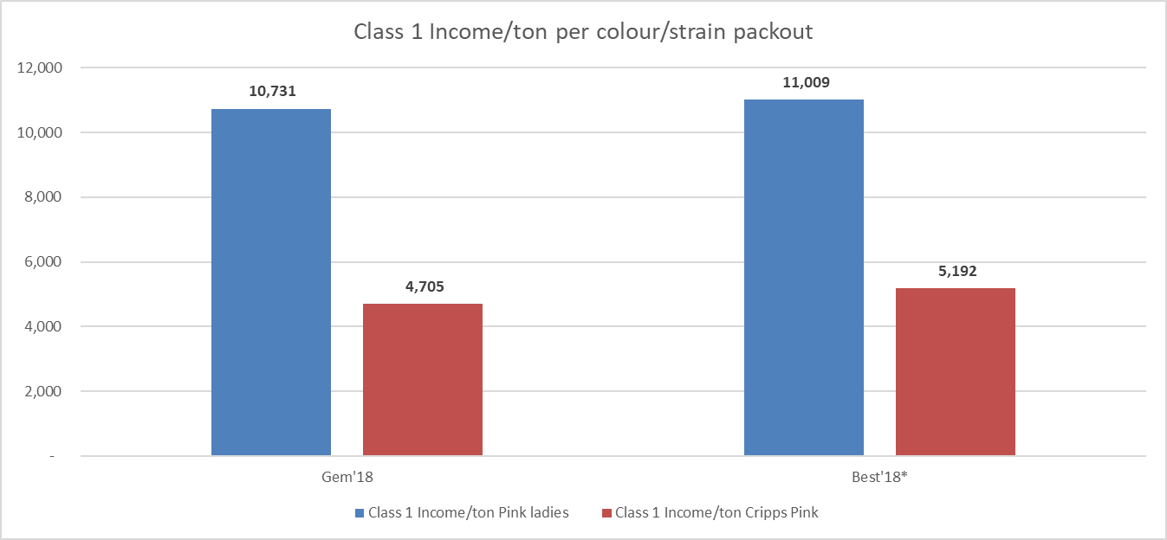
bdk auditors | Fruit Benchmarking survey 2019 10

Slide 75
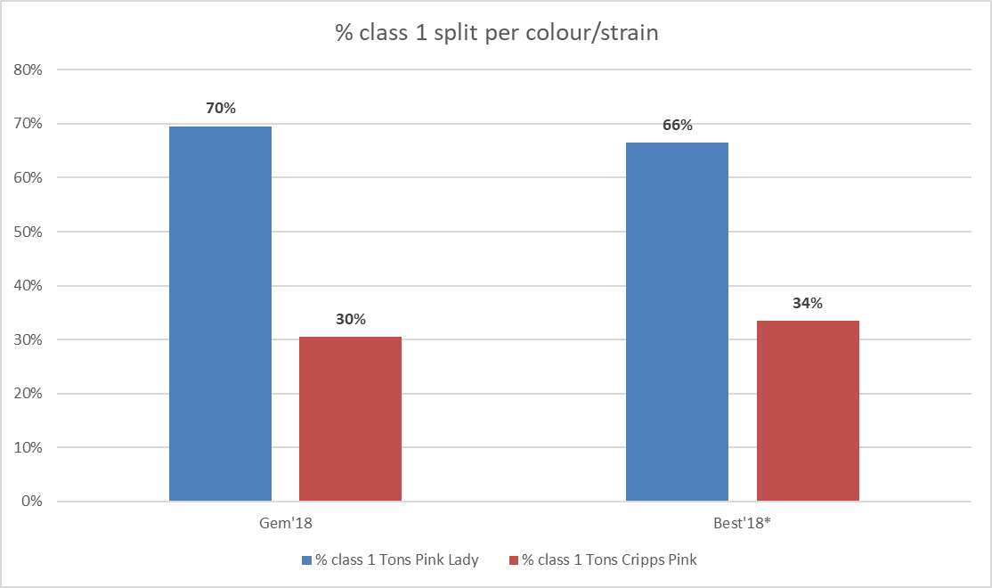
bdk auditors | Fruit Benchmarking survey 2019 10

Slide 76
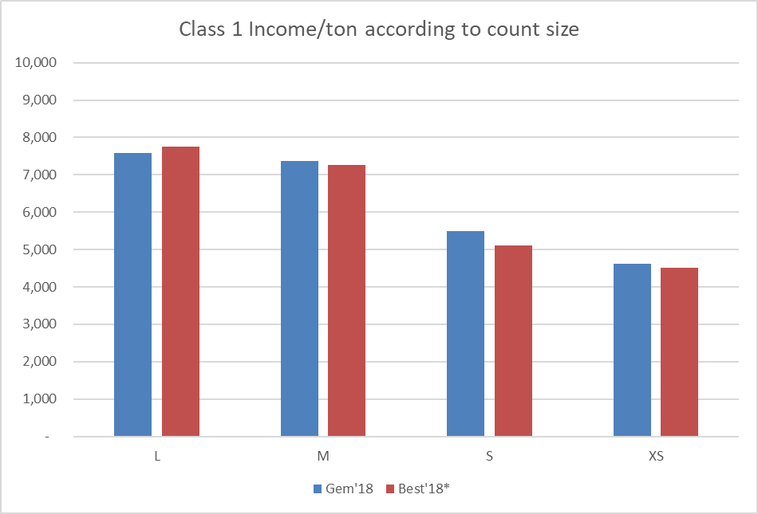
INCOME FOR PACKHAMS ON
CLASS 1 TONS 2018/2019 YEAR
bdk auditors | Fruit Benchmarking survey 2019 10

Slide 77
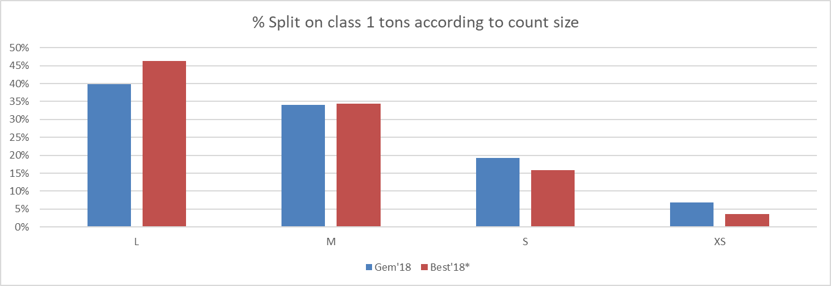
bdk auditors | Fruit Benchmarking survey 2019 10

Slide 78
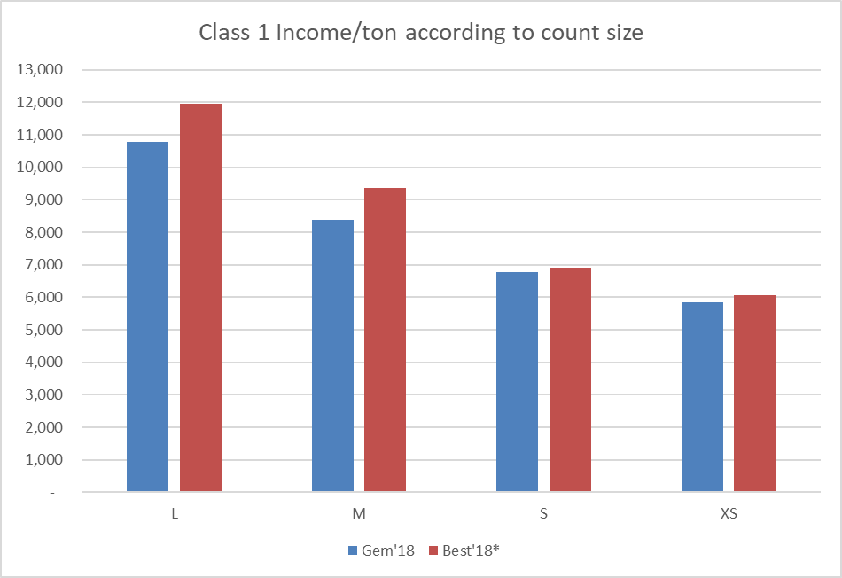
INCOME FOR FORELLE ON
CLASS 1 TONS 2018/2019 YEAR
bdk auditors | Fruit Benchmarking survey 2019 10

Slide 79
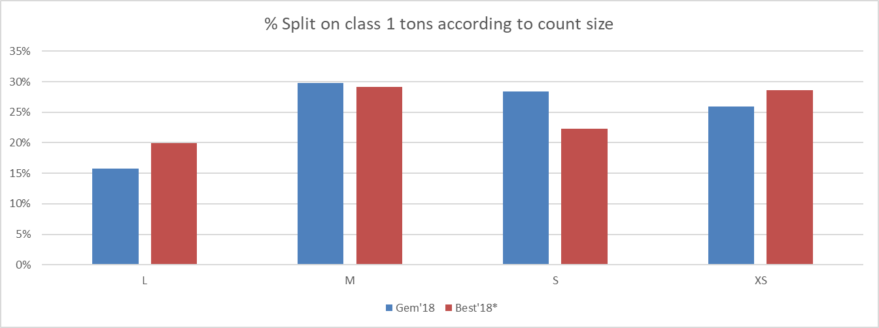
bdk auditors | Fruit Benchmarking survey 2019 10

Slide 80
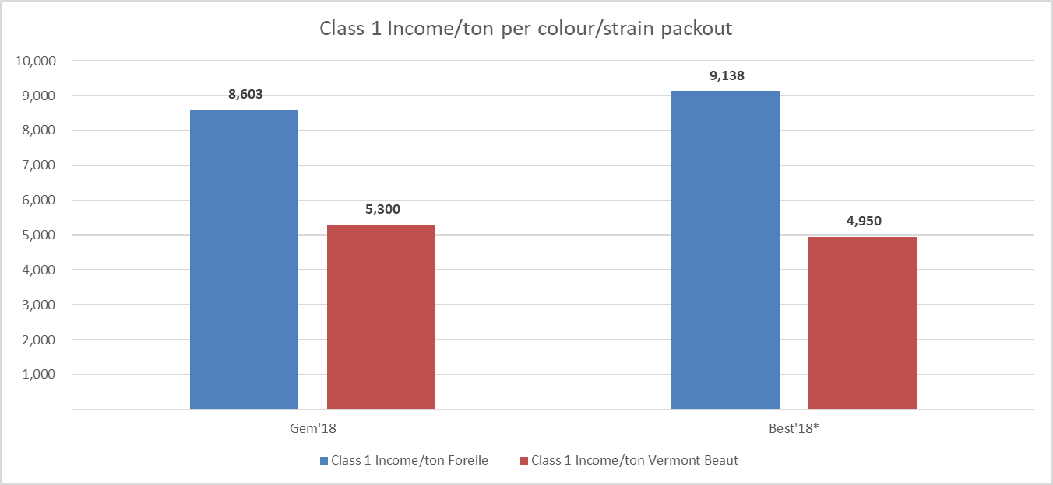
bdk auditors | Fruit Benchmarking survey 2019 10

Slide 81
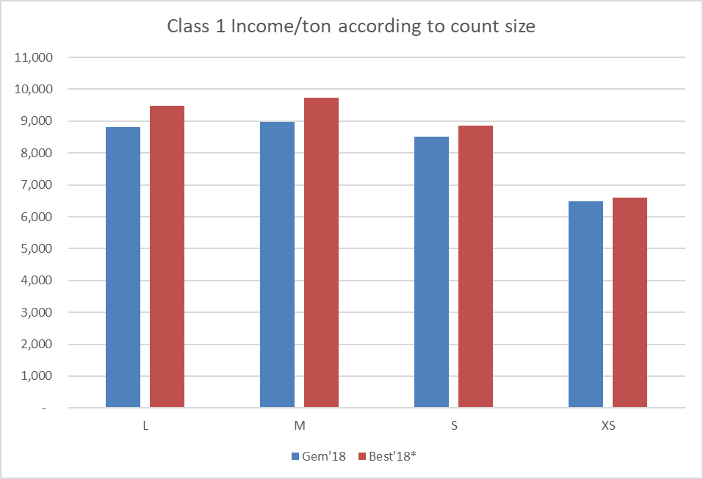
INCOME FOR ROSEMARIE ON
CLASS 1 TONS 2018/2019 YEAR
bdk auditors | Fruit Benchmarking survey 2019 10

Slide 82
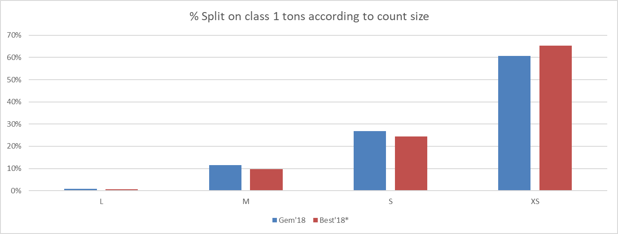
bdk auditors | Fruit Benchmarking survey 2019 10

Slide 83
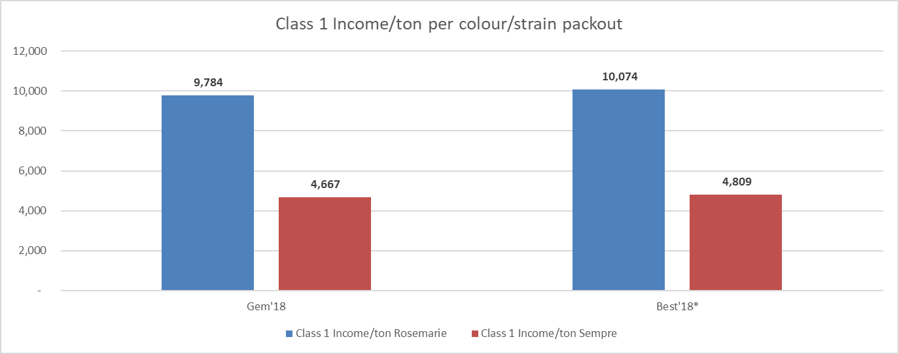
bdk auditors | Fruit Benchmarking survey 2019 10

Slide 84

p.108

Slide 85
INKOMSTE VIR GRANNY'S PER
TON 2018/2019 JAAR |  |  |  |  |  | Beste | Beste | Beste
 |  |  |  |  |  | uitpakke | prys | Produksie
 | Gem'18 | Gem'17 | 25 % '18 | 25 % '17 | MY PLAAS | MY PLAAS | MY PLAAS | MY PLAAS
 |  |  |  |  | 24 | 24 | 24 | 24
Draende hektare | 552 | 560 |  |  | 17
Inkomste vergelykings per ton
Gemiddelde inkomste per ton | 4,110 | 3,365 | 4,525 | 4,062 | 4,019 | 4,019 | 4,525 | 4,019
Klas 1 en Klas 2 inkomste per ton | 6,559 | 5,684 | 6,876 | 6,187 | 7,207 | 7,207 | 6,876 | 7,207
Totale klas 1 inkomste per ton | 7,838 | 6,862 | 7,781 | 7,296 | 8,164 | 8,164 | 7,781 | 8,164
Prys indeks | 91 | 83 | 100 | 100 | 89 | 89 | 100 | 89
Inkomste ontleding per klas
Klas 1 inkomste per ton | 7,838 | 6,862 | 7,781 | 7,296 | 8,164 | 8,164 | 7,781 | 8,164
Klas 2 inkomste per ton | 2,678 | 2,530 | 3,315 | 2,498 | 3,788 | 3,788 | 3,315 | 3,788
Klas 2.5 inkomste per ton | 1,447 | 808 | 1,418 | 1,631 | 1,669 | 1,669 | 1,418 | 1,669
Klas 3 inkomste per ton | 1,132 | 1,002 | 1,037 | 986 | 1,065 | 1,065 | 1,037 | 1,065
 | Gem'18 | Gem'17 | 25 % '18 | 25 % '17
Klas 1 produksie per telling grootte
% XL 64-90 | 7% | 5% | 6% | 4% | 3% | 3% | 3% | 3%
% L 100-110 | 14% | 14% | 14% | 14% | 9% | 9% | 9% | 9%
% M 120-135 | 31% | 30% | 32% | 31% | 28% | 28% | 28% | 28%
% S 150-180 | 35% | 37% | 36% | 36% | 39% | 39% | 39% | 39%
% XS 198-216 | 12% | 14% | 12% | 12% | 20% | 20% | 20% | 20%
% XXS 237 | 1% | 1% | 1% | 2% | 1% | 1% | 1% | 1%
bdk auditors | Fruit Benchmarking survey 2019 10

Slide 86
INKOMSTE VIR GRANNY'S PER
TON 2018/2019 JAAR |  |  |  |  |  | Beste | Beste | Beste
 |  |  |  |  |  | uitpakke | prys | Produksie
 | Gem'18 | Gem'17 | 25 % '18 | 25 % '17 | MY PLAAS | MY PLAAS | MY PLAAS | MY PLAAS
Klas 1 produksie per mark segment
% SA1/UK1 tonne | 67% | 55% | 57% | 34% | 71% | 71% | 71% | 71%
% Rest of Class 1 tonnes | 33% | 45% | 43% | 66% | 29% | 29% | 29% | 29%
 | Gem'18 | Gem'17 | 25 % '18 | 25 % '17
TON PER HEKTAAR APPELS GEPRODUSEER
Klas 1 ton per hektaar | 41% | 37% | 47% | 45% | 37% | 47% | 37% | 37%
Klas 2 ton per hektaar | 13% | 14% | 12% | 13% | 10% | 12% | 10% | 10%
Klas 2.5 ton per hektaar | 12% | 12% | 8% | 7% | 7% | 8% | 7% | 7%
Klas 3 ton per hektaar | 34% | 37% | 32% | 35% | 45% | 32% | 45% | 45%
Totale produksie per hektaar | 63 | 65 | 70 | 72 | 70 | 70 | 70 | 70
Produksie indeks | 90 | 91 | 100 | 100 | 101 | 101 | 101 | 100
% Klas 1 en Klas 2 van totaal | 54% | 51% | 59% | 58% | 47% | 59% | 47% | 47%
% Vrugte in 'n boks | 66% | 63% | 68% | 65% | 55% | 68% | 55% | 55%
Inkomste per draende ha | 258,416 | 218,552 | 315,716 | 291,143 | 282,645 | 337,090 | 267,002 | 280,392
Boom ouderdomme |  |  | * |  | -33,071 | 54,445 | -15,643 | -2,253
0 - 3yrs | 9% |  | 12% |  |  | 165% | -47% | -7%
4 - 6 yrs | 6% |  | 8%
7yr + | 85% |  | 81%
* Beste 25% inkomste per draende hektaar per variëtiet
bdk auditors | Fruit Benchmarking survey 2019 10

Slide 87
INKOMSTE VIR ROYAL GALA PER |  |  |  |  |  | Beste | Beste | Beste
TON 2018/2019 JAAR |  |  |  |  |  | uitpakke | prys | Produksie
 |  |  |  |  | 24 | 24 | 24 | 24
 | Gem'18 | Gem'17 | 25 % '18 | 25 % '17 | MY PLAAS | MY PLAAS | MY PLAAS | MY PLAAS
Produserende hektare | 523 | 490 |  |  | 11
Inkomste vergelykings per ton
Gemiddelde inkomste per ton | 5,017 | 4,391 | 5,716 | 5,476 | 6,017 | 6,017 | 5,716 | 6,017
Klas 1 en Klas 2 inkomste per ton | 6,611 | 5,782 | 7,133 | 6,814 | 7,790 | 7,790 | 7,133 | 7,790
Totale klas 1 inkomste per ton | 7,184 | 6,265 | 7,761 | 7,356 | 8,437 | 8,437 | 7,761 | 8,437
Prys indeks | 88 | 80 | 100 | 100 | 105 | 105 | 100 | 105
Inkomste ontleding per klas
Klas 1 inkomste per ton | 7,184 | 6,265 | 7,761 | 7,356 | 8,437 | 8,437 | 7,761 | 8,437
Klas 2 inkomste per ton | 3,177 | 2,737 | 3,878 | 3,256 | 4,082 | 4,082 | 3,878 | 4,082
Klas 2.5 inkomste per ton | 1,860 | 1,328 | 2,255 | 2,048 | 3,018 | 3,018 | 2,255 | 3,018
Klas 3 inkomste per ton | 1,054 | 1,077 | 929 | 1,047 | 778 | 778 | 929 | 778
 | Gem'18 | Gem'17 | 25 % '18 | 25 % '17
Klas 1 produksie per telling grootte
% XL 64-90 | 1% | 1% | 1% | 1% | 2% | 2% | 2% | 2%
% L 100-110 | 7% | 5% | 9% | 6% | 12% | 12% | 12% | 12%
% M 120-135 | 25% | 22% | 28% | 24% | 36% | 36% | 36% | 36%
% S 150-180 | 43% | 44% | 44% | 42% | 35% | 35% | 35% | 35%
% XS 198-216 | 21% | 25% | 15% | 24% | 13% | 13% | 13% | 13%
% XXS 237 | 3% | 3% | 2% | 4% | 2% | 2% | 2% | 2%
bdk auditors | Fruit Benchmarking survey 2019 10

Slide 88
INKOMSTE VIR ROYAL GALA PER |  |  |  |  |  | Beste | Beste | Beste
TON 2018/2019 JAAR |  |  |  |  |  | uitpakke | prys | Produksie
 |  |  |  |  | 24 | 24 | 24 | 24
 | Gem'18 | Gem'17 | 25 % '18 | 25 % '17 | MY PLAAS | MY PLAAS | MY PLAAS | MY PLAAS
Klas 1 produksie per mark segment
% SA1/UK1 tonne | 70% | 69% | 59% | 53% | 87% | 87% | 87% | 87%
% Rest of Class 1 tonnes | 30% | 31% | 41% | 47% | 13% | 13% | 13% | 13%
Klas 1 produksie per kleur/strain
% class 1 tons Royal Beaut/Royal Gala Red (75-100%) | 22% | 24% | 27% | 26% | 27% | 27% | 27% | 27%
% class 1 tons Royal Gala (50-100%) | 53% | 49% | 47% | 48% | 7% | 7% | 7% | 7%
% class 1 tons Gala (<50%) | 25% | 27% | 26% | 26% | 65% | 65% | 65% | 65%
 | Gem'18 | Gem'17 | 25 % '18 | 25 % '17
TON PER HEKTAAR APPELS GEPRODUSEER
Klas 1 ton per hektaar | 60% | 60% | 64% | 66% | 62% | 64% | 62% | 62%
Klas 2 ton per hektaar | 10% | 10% | 12% | 10% | 11% | 12% | 11% | 11%
Klas 2.5 ton per hektaar | 8% | 9% | 6% | 7% | 5% | 6% | 5% | 5%
Klas 3 ton per hektaar | 22% | 22% | 18% | 18% | 22% | 18% | 22% | 22%
Totale produksie per hektaar | 59 | 68 | 67 | 78 | 59 | 59 | 59 | 67
Produksie indeks | 88 | 88 | 100 | 100 | 88 | 88 | 88 | 100
% Klas 1 en Klas 2 van totaal | 70% | 70% | 76% | 76% | 73% | 76% | 73% | 73%
% Vrugte in 'n boks | 78% | 78% | 82% | 82% | 78% | 82% | 78% | 78%
Inkomste per draende ha | 297,032 | 300,077 | 384,766 | 426,869 | 356,087 | 366,445 | 329,385 | 404,996
Boom ouderdomme |  |  | *
0 - 3yrs | 20% |  | 13%
4 - 6 yrs | 16% |  | 16%
7yr + | 65% |  | 70% |  | -28,679 | 10,358 | -26,702 | 48,909
* Beste 25% inkomste per draende hektaar per variëtiet |  |  |  |  |  | 36% | -93% | 171%
bdk auditors | Fruit Benchmarking survey 2019 10

Slide 89
INKOMSTE VIR PINK LADIES PER |  |  |  |  |  | Beste | Beste | Beste
TON 2018/2019 JAAR |  |  |  |  |  | uitpakke | prys | Produksie
 |  |  |  |  | 24 | 24 | 24 | 24
 | Gem'18 | Gem'17 | 25 % '18 | 25 % '17 | MY PLAAS | MY PLAAS | MY PLAAS | MY PLAAS
Produserende hektare | 383 | 374 |  |  | 7
Inkomste vergelykings per ton
Gemiddelde inkomste per ton | 5,077 | 4,364 | 5,791 | 5,528 | 6,593 | 6,593 | 5,791 | 6,593
Klas 1 en Klas 2 inkomste per ton | 7,708 | 6,884 | 8,068 | 7,810 | 10,238 | 10,238 | 8,068 | 10,238
Totale klas 1 inkomste per ton | 8,895 | 8,645 | 9,060 | 9,322 | 11,722 | 11,722 | 9,060 | 11,722
Prys indeks | 88 | 79 | 100 | 100 | 114 | 114 | 100 | 114
Inkomste ontleding per klas
Klas 1 inkomste per ton | 8,895 | 8,645 | 9,060 | 9,322 | 11,722 | 11,722 | 9,060 | 11,722
Klas 2 inkomste per ton | 3,402 | 1,932 | 3,598 | 1,918 | 5,071 | 5,071 | 3,598 | 5,071
Klas 2.5 inkomste per ton | 2,046 | 1,497 | 2,095 | 1,708 | 4,276 | 4,276 | 2,095 | 4,276
Klas 3 inkomste per ton | 1,094 | 1,401 | 1,113 | 1,630 | 846 | 846 | 1,113 | 846
 | Gem'18 | Gem'17 | 25 % '18 | 25 % '17
Klas 1 produksie per telling grootte
% XL 64-90 | 7% | 4% | 9% | 6% | 19% | 19% | 19% | 19%
% L 100-110 | 18% | 18% | 19% | 21% | 31% | 31% | 31% | 31%
% M 120-135 | 33% | 36% | 33% | 35% | 35% | 35% | 35% | 35%
% S 150-180 | 33% | 33% | 32% | 32% | 12% | 12% | 12% | 12%
% XS 198-216 | 8% | 8% | 7% | 6% | 2% | 2% | 2% | 2%
% XXS 237 | 1% | 1% | 1% | 0% | 1% | 1% | 1% | 1%
bdk auditors | Fruit Benchmarking survey 2019 10

Slide 90
INKOMSTE VIR PINK LADIES PER |  |  |  |  |  | Beste | Beste | Beste
TON 2018/2019 JAAR |  |  |  |  |  | uitpakke | prys | Produksie
 |  |  |  |  | 24 | 24 | 24 | 24
 | Gem'18 | Gem'17 | 25 % '18 | 25 % '17 | MY PLAAS | MY PLAAS | MY PLAAS | MY PLAAS
Klas 1 produksie per mark segment
% SA1/UK1 tonne | 70% | 61% | 70% | 66% | 66% | 66% | 66% | 66%
% Rest of Class 1 tonnes | 30% | 39% | 30% | 34% | 34% | 34% | 34% | 34%
Klas 1 produksie per kleur/strain
% class 1 Tons Pink Lady | 70% | 57% | 66% | 61% | 95% | 95% | 95% | 95%
% class 1 Tons Cripps Pink | 30% | 43% | 34% | 39% | 5% | 5% | 5% | 5%
 | Gem'18 | Gem'17 | 25 % '18 | 25 % '17
TON PER HEKTAAR APPELS GEPRODUSEER
Klas 1 ton per hektaar | 46% | 40% | 54% | 50% | 43% | 54% | 43% | 43%
Klas 2 ton per hektaar | 13% | 14% | 12% | 13% | 12% | 12% | 12% | 12%
Klas 2.5 ton per hektaar | 13% | 12% | 12% | 9% | 17% | 12% | 17% | 17%
Klas 3 ton per hektaar | 28% | 34% | 22% | 28% | 28% | 22% | 28% | 28%
Totale produksie per hektaar | 68 | 69 | 84 | 83 | 54 | 54 | 54 | 84
Produksie indeks | 81 | 83 | 100 | 100 | 64 | 64 | 64 | 100
% Klas 1 en Klas 2 van totaal | 58% | 54% | 66% | 63% | 55% | 66% | 55% | 55%
% Vrugte in 'n boks | 72% | 66% | 78% | 72% | 72% | 78% | 72% | 72%
Inkomste per draende ha | 346,325 | 300,439 | 487,266 | 458,996 | 354,057 | 408,191 | 267,090 | 554,773
Boom ouderdomme |  |  | *
0 - 3yrs | 20% |  | 15% |  | 0%
4 - 6 yrs | 8% |  | 7% |  | 0%
7yr + | 73% |  | 78% |  | 100%
* Beste 25% inkomste per draende hektaar per variëtiet |  |  |  |  | -133,209 | 54,134 | -86,967 | 200,716
 |  |  |  |  |  | 41% | -65% | 151%
bdk auditors | Fruit Benchmarking survey 2019 10

Slide 91

p.194

Slide 92
Benchmarking Survey: 2018/2019
AGEING OF TREES ON FARMS
 | Best 25% | Average | MY PLAAS
*Best 25 income per bearing ha |  |  | 24
All Apples | 17 | 18 | 19
Granny's | 25 | 27 | 31
Goldens | 28 | 25 | 25
Royal Galas | 14 | 13 | 14
S. & Topred | 22 | 25 | 21
Braeburn | 20 | 20 | 9
Fuji | 11 | 11 | 9
Pink Ladies | 12 | 12 | 9
Pan. Goldens | 17 | 10 | 5
Sundowners | 9 | 10 | 13
Packhams | 21 | 20 | 20
Forelle | 21 | 21 | 18
BC's | 22 | 23 | 18
Abate Fetel | 16 | 19 | 18
Rosemarie | 18 | 18 | 18
Total for farm | 18 | 18 | 19
bdk auditors | Fruit Benchmarking survey 2019 10

Slide 93
BEARING HECTARE PER VARIETY
AS % OF TOTAL BEARING HECTARES
Income and Expense Survey: 2019
 |  |  | MY PLAAS
Varieties | Average | Best 25% | 24
Granny | 15% | 12% | 17%
Golden | 19% | 20% | 25%
Royal Gala | 14% | 12% | 12%
S.King & Topred | 6% | 5% | 9%
Braeburn | 4% | 4% | 4%
Fuji | 9% | 9% | 15%
Pink Ladies | 10% | 11% | 7%
Pan. Goldens | 2% | 2% | 3%
Sundowners | 4% | 5% | 4%
Other apples | 1% | 1% | 0%
Total apples | 83% | 81% | 94%
Pears - other | 1% | 1% | 0%
Packhams | 8% | 10% | 3%
Forelle | 3% | 3% | 2%
BC's | 1% | 2% | 0%
Abate Fetel | 2% | 1% | 0%
Rosemarie | 1% | 1% | 0%
Ander (N) | 0% | 0% | 0%
Plums | 0% | 0% | 0%
 | 100% | 100% | 100%
 |  | *
*Best 25% Profit per producing hectare
bdk auditors | Fruit Benchmarking survey 2019 10

Slide 94
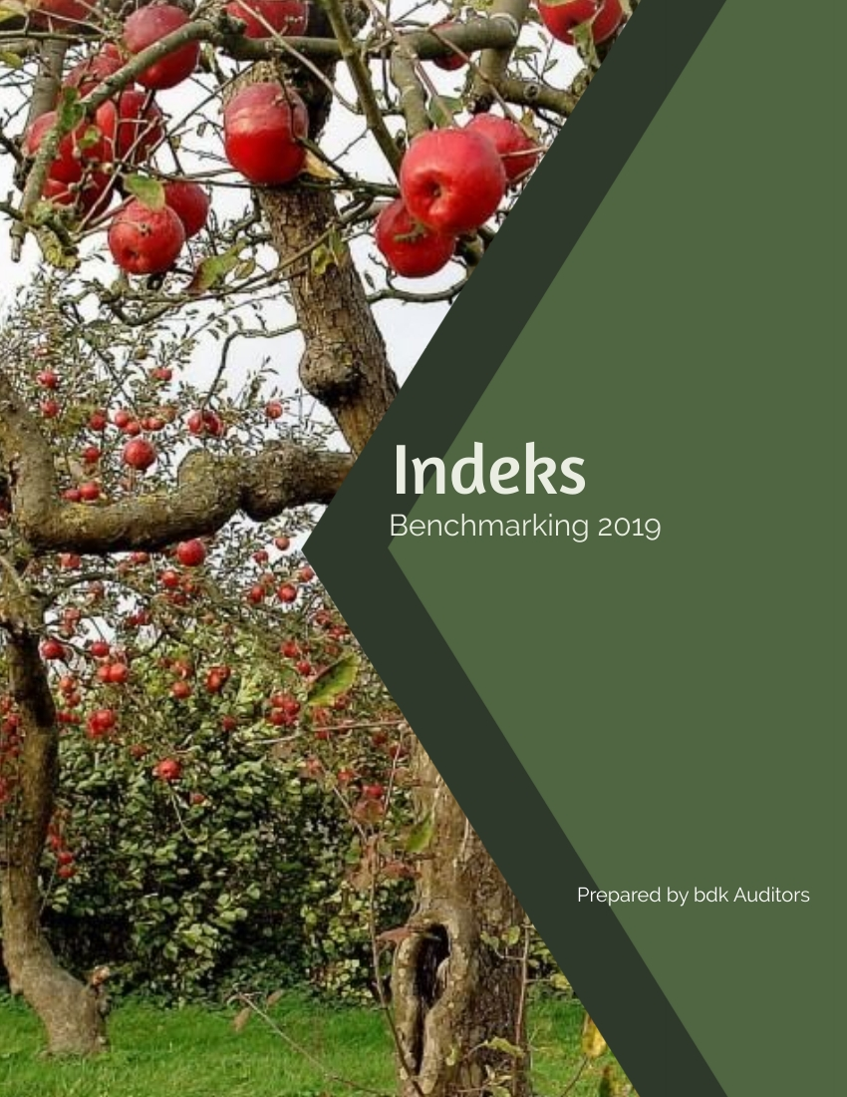
p.204

Slide 95
Benchmarking Survey: 2018/2019
Index scorecard
Index measured against best practice |  |  | MY PLAAS
 | Best 25% | Average | 24
Ageing all apples | 17 | 18 | 19
Index for profitability per ha. | 100 | 60 | 104
Index for profitability per ton | 100 | 69 | 112
Index for expenses per ha. | 100 | 101 | 84
Index for expenses per ton | 100 | 117 | 90
Index for production | 100 | 90 | 88
Granny's
Ageing all apples | 25 | 27 | 31
Index for price per ton | 100 | 91 | 89
Index for production per ha. | 100 | 90 | 101
% 0 - 3 years | 12% | 9% | 1%
% 4 - 6 years | 8% | 6% | 4%
% + 7 years | 81% | 85% | 95%
Goldens's
Ageing all apples | 28 | 25 | 25
Index for price per ton | 100 | 91 | 84
Index for production per ha. | 100 | 90 | 88
% 0 - 3 years | 0% | 7% | 0%
% 4 - 6 years | 4% | 5% | 1%
% + 7 years | 95% | 88% | 99%
bdk auditors | Fruit Benchmarking survey 2019 10

Slide 96
Benchmarking Survey: 2018/2019
Index scorecard
Index measured against best practice |  |  | MY PLAAS
 | Best 25% | Average | 24
Royal Galas
Ageing all apples | 14 | 13 | 14
Index for price per ton | 100 | 88 | 105
Index for production per ha. | 100 | 88 | 88
% 0 - 3 years | 13% | 20% | 0%
% 4 - 6 years | 16% | 16% | 14%
% + 7 years | 70% | 65% | 86%
S. & Topred
Ageing all apples | 22 | 25 | 21
Index for price per ton | 100 | 102 | 112
Index for production per ha. | 100 | 75 | 73
% 0 - 3 years | 2% | 4% | 0%
% 4 - 6 years | 15% | 11% | 38%
% + 7 years | 83% | 85% | 62%
 | Best 25% | Average | 24
Braeburn
Ageing all apples | 20 | 20 | 9
Index for price per ton | 100 | 88 | 96
Index for production per ha. | 100 | 87 | 91
% 0 - 3 years | 1% | 4% | 0%
% 4 - 6 years | 0% | 5% | 0%
% + 7 years | 99% | 91% | 100%
bdk auditors | Fruit Benchmarking survey 2019 10

Slide 97
Benchmarking Survey: 2018/2019
Index scorecard
Index measured against best practice |  |  | MY PLAAS
 | Best 25% | Average | 24
Fuji
Ageing all apples | 11 | 11 | 9
Index for price per ton | 100 | 89 | 93
Index for production per ha. | 100 | 85 | 55
% 0 - 3 years | 4% | 10% | 0%
% 4 - 6 years | 20% | 21% | 39%
% + 7 years | 76% | 69% | 61%
Pink Ladies
Ageing all apples | 12 | 12 | 9
Index for price per ton | 100 | 88 | 114
Index for production per ha. | 100 | 81 | 64
% 0 - 3 years | 15% | 20% | 0%
% 4 - 6 years | 7% | 8% | 0%
% + 7 years | 78% | 73% | 100%
Pan. Goldens
Ageing all apples | 17 | 10 | 5
Index for price per ton | 100 | 98 | 99
Index for production per ha. | 100 | 55 | 53
% 0 - 3 years | 20% | 26% | 0%
% 4 - 6 years | 15% | 22% | 100%
% + 7 years | 66% | 52% | 0%
bdk auditors | Fruit Benchmarking survey 2019 10

Slide 98
Benchmarking Survey: 2018/2019
Index scorecard
Index measured against best practice |  |  | MY PLAAS
 | Best 25% | Average | 24
Sundowners
Ageing all apples | 9 | 10 | 13
Index for price per ton | 100 | 99 | 112
Index for production per ha. | 100 | 69 | 95
% 0 - 3 years | 41% | 35% | 0%
% 4 - 6 years | 10% | 16% | 0%
% + 7 years | 49% | 49% | 100%
 | Best 25% | Average | 24
Packhams
Ageing all apples | 21 | 20 | 20
Index for price per ton | 100 | 95 | 105
Index for production per ha. | 100 | 76 | 75
% 0 - 3 years | 7% | 11% | 0%
% 4 - 6 years | 9% | 15% | 0%
% + 7 years | 84% | 74% | 100%
Forelle
Ageing all apples | 21 | 21 | 18
Index for price per ton | 100 | 92 | 103
Index for production per ha. | 100 | 87 | 100
% 0 - 3 years | 11% | 3% | 0%
% 4 - 6 years | 0% | 1% | 0%
% + 7 years | 89% | 95% | 100%
bdk auditors | Fruit Benchmarking survey 2019 10

Slide 99
Benchmarking Survey: 2018/2019
Index scorecard
Index measured against best practice |  |  | MY PLAAS
 | Best 25% | Average | 24
BC's
Ageing all apples | 22 | 23 | 18
Index for price per ton | 100 | 98 | 42
Index for production per ha. | 100 | 69 | 85
% 0 - 3 years | 1% | 1% | 0%
% 4 - 6 years | 0% | 3% | 0%
% + 7 years | 99% | 97% | 100%
Abate Fetel
Ageing all apples | 16 | 19 | 18
Index for price per ton | 100 | 84 | #DIV/0!
Index for production per ha. | 100 | 87 | #DIV/0!
% 0 - 3 years | 0% | 1% | 0%
% 4 - 6 years | 0% | 0% | 0%
% + 7 years | 100% | 98% | 100%
Rosemarie
Ageing all apples | 18 | 18 | 18
Index for price per ton | 100 | 89 | 34
Index for production per ha. | 100 | 79 | 10
% 0 - 3 years | 5% | 26% | 0%
% 4 - 6 years | 22% | 11% | 0%
% + 7 years | 73% | 63% | 100%
bdk auditors | Fruit Benchmarking survey 2019 10

Slide 100
bdk auditors | Fruit Benchmarking survey 2019 10

Slide 101
Net profit per producing ha per farm - 2018/2019 year
Farm no | Net profit |  | 2018 Production |  | 2017 Production
 |  |  | ton/bearing ha |  | ton/bearing ha
 | Group average |  | 60 ton/ha |  | 64 ton/ha
62 | 75,559 |  | 57 |  | 69
4 | 72,427 |  | 52 |  | 54
31 | 71,494 |  | 52 |  | 69
39 | 70,747 |  | 58 |  | 70
63 | 70,196 |  | 66 |  | 68
6 | 69,754 |  | 58 |  | 57
16 | 63,507 |  | 47 |  | 48
60 | 63,488 |  | 62 |  | 60
35 | 61,184 |  | 54 |  | 73
43 | 59,513 |  | 60 |  | 74
48 | 57,168 |  | 57 |  | 58
18 | 56,570 |  | 49 |  | 51
1 | 55,889 |  | 62 |  | 67
22 | 54,715 |  | 68 |  | 77
44 | 53,051 |  | 53 |  | 59
42 | 52,840 |  | 58 |  | 70
58 | 52,605 |  | 62 |  | 63
26 | 50,614 |  | 41 |  | 63
19 | 49,559 |  | 52 |  | 58
40 | 49,442 |  | 64 |  | 66
10 | 46,620 |  | 60 |  | 61
bdk auditors | Fruit Benchmarking survey 2019 10

Slide 102
Net profit per producing ha per farm - 2018/2019 year
Farm no | Net profit |  | 2018 Production |  | 2017 Production
 |  |  | ton/bearing ha |  | ton/bearing ha
45 | 39,469 |  | 57 |  | 51
23 | 39,450 |  | 57 |  | 55
7 | 35,408 |  | 82 |  | 69
54 | 34,213 |  | 53 |  | 49
8 | 23,509 |  | 55 |  | 69
41 | 22,418 |  | 54 |  | 81
38 | 21,635 |  | 53 |  | 56
14 | 8,928 |  | 52 |  | 86
29 | 8,402 |  | 46 |  | 54
56 | 5,629 |  | 53 |  | 63
30 | -987 |  | 49 |  | 64
11 | -5,516 |  | 68 |  | 70
20 | -9,759 |  | 49 |  | 68
12 | -23,503 |  | 49 |  | 47
5 | -39,189 |  | 48 |  | 50
47 | -87,425 |  | 31 |  | 38
17 | -129,315 |  | 31 |  | 69
(Note: "Profit" is the profit before interest, depreciation, taxation and
owners remuneration.)
bdk auditors | Fruit Benchmarking survey 2019 10

Slide 103
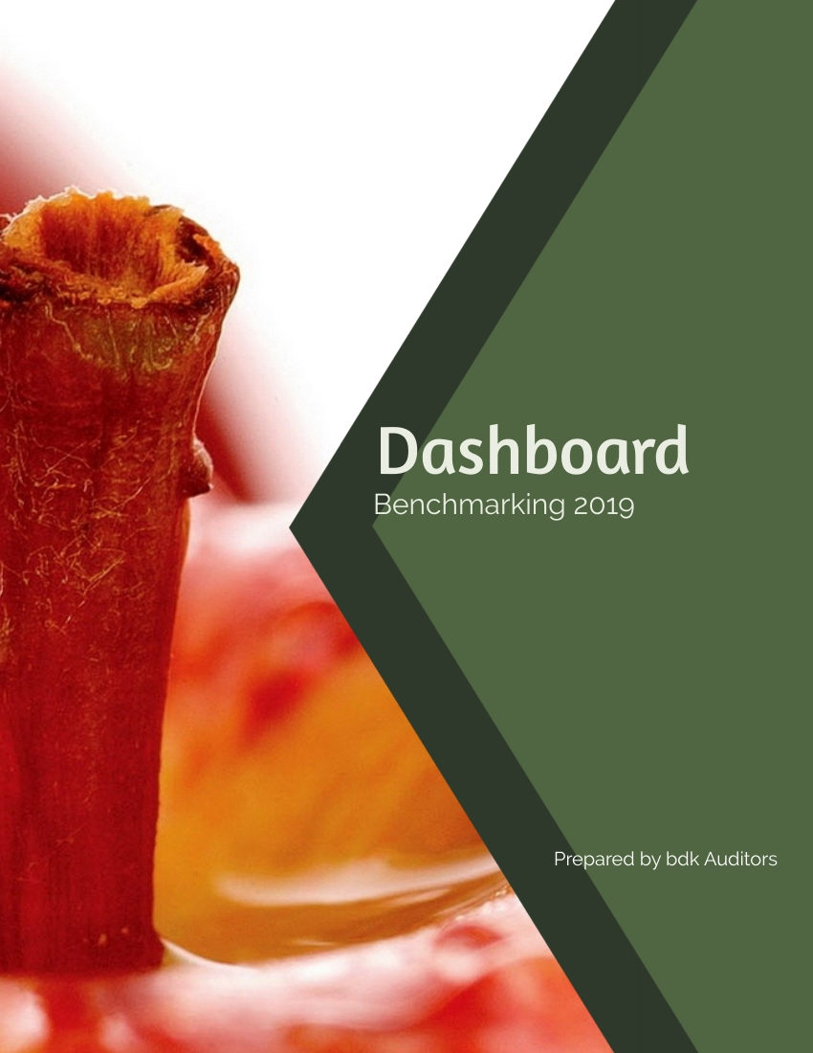
p.232

Slide 104
DASHBOARD 2018/2019 - YOU vs. BEST PROFIT FARMS
NETTO WINS PER PRODUSERENDE HEKTAAR |  | Beste | MY PLAAS
 | Gem18/19 | 25 % 18/19 | 24 | Verskil
Inkomste | 236,837 | 286,298 | 266,702 | (19,595)
(Inkomste per draende hektaar): | 264,371 | 308,092 | 271,478 | (36,614)
Min Uitgawes: | 161,042 | 159,585 | 134,588 | 24,997
Totale arbeidskoste | 76,935 | 76,653 | 58,761 | 17,892
(Uitgesluit winsdeel)
Winsdeel | 1,826 | 2,819 | 7,732 | (4,912)
Oesbeskermning | 23,723 | 23,052 | 21,268 | 1,783
(Ingesluit onkruidoder)
Kunsmis | 5,696 | 5,598 | 4,128 | 1,470
Reparasies | 11,482 | 11,787 | 10,627 | 1,160
(uitgesluit geboue)
Reparasies geboue | 5,228 | 4,972 | 1,347 | 3,625
Brandstof & olie | 8,065 | 8,136 | 5,146 | 2,990
Vervoer | 4,901 | 4,911 | 5,918 | (1,008)
Elektrisiteit | 6,129 | 6,070 | 6,138 | (67)
Diverse uitgawes | 12,477 | 10,947 | 6,414 | 4,533
Ander uitgawes | 4,579 | 4,641 | 7,109 | (2,468)
bdk auditors | Fruit Benchmarking survey 2019 10

Slide 105
DASHBOARD 2018/2019 - YOU vs. BEST PROFIT FARMS
NETTO WINS PER PRODUSERENDE HEKTAAR |  | Beste | MY PLAAS
 | Gem18/19 | 25 % 18/19 | 24 | Verskil
Wins/- verlies per produserende hektaar | 75,795 | 126,712 | 132,114 | 5,402
Wins/- verlies per prod hektaar uitgsl. winsdeel | 77,621 | 129,532 | 139,846 | 10,315
Totale uitgawes per ton geproduseer | 2,975 | 2,547 | 2,300 | 247
Total arbeidskoste per ton geproduseer | 1,421 | 1,223 | 1,004 | 219
Oesbeskerming en kunsmis per ton geprod. | 543 | 457 | 434 | 23
Totale inkomste per ton geproduseer | 4,375 | 4,569 | 4,558 | -11
Inkomste per ton indeks | 96 | 100 | 100
Ton per ha. | 60 | 67 | 60
Wins per ton | 1400 | 2022 | 2,258 | 236
Wins per ha indeks | 60 | 100 | 104
Wins per ton indeks | 69 | 100 | 112
Uitgawe per ha indeks | 101 | 100 | 84
Uitgawe per ton indeks | 117 | 100 | 90
Produksie indeks | 90 | 100 | 88
Netto wins voor rente betaal, |  | *
waardevermindering en kapitale investering
* = Profiel van die plase met die beste 25% wins per produserende hektaar
Ouderdomsverdeling alle variëteite totaal:
0 - 3yrs | 13% | 10% | 0%
4 - 6 yrs | 11% | 14% | 16%
7yr + | 75% | 76% | 83%
bdk auditors | Fruit Benchmarking survey 2019 10

Slide 106
DASHBOARD 2018/2019 - YOU vs. BEST PROFIT FARMS
 | Best 25% | Plaasno. |  |  | Best 25% | Plaasno.
 | profit* | 24 |  |  | profit* | 24
Granny % ha | 12% | 17% |  | Pan. Goldens % ha | 2% | 3%
Income/bear ha | 297,198 | 282,645 |  | Income/bear ha | 266,002 | 160,175
Income/ton | 4,257 | 4,019 |  | Income/ton | 4,195 | 3,993
Packout% 1 + 2 | 61% | 47% |  | Packout% 1 + 2 | 69% | 56%
Ton/ha | 70 | 70 |  | Ton/ha | 63 | 40
Golden % ha | 20% | 25% |  | Sundowners % ha | 5% | 4%
Income/bear ha | 289,311 | 256,513 |  | Income/bear ha | 410,903 | 532,469
Income/ton | 3,636 | 3,539 |  | Income/ton | 5,651 | 6,206
Packout% 1 + 2 | 59% | 48% |  | Packout% 1 + 2 | 63% | 63%
Ton/ha | 80 | 72 |  | Ton/ha | 73 | 86
Royal Gala % ha | 12% | 12% |  | Total apples % ha | 81% | 94%
Income/bear ha | 352,564 | 356,087 |  | Income/bear ha | 320,330 | 270,660
Income/ton | 5,225 | 6,017 |  | Income/ton | 4,586 | 4,538
Packout% 1 + 2 | 73% | 73% |  | Packout% 1 + 2 | 61% | 54%
Ton/ha | 67 | 59 |  | Ton/ha | 70 | 60
bdk auditors | Fruit Benchmarking survey 2019 10

Slide 107
DASHBOARD 2018/2019 - YOU vs. BEST PROFIT FARMS
S.King & Topred % ha | 5% | 9% |  | Packhams % ha | 10% | 3%
Income/bear ha | 177,461 | 193,708 |  | Income/bear ha | 274,229 | 254,405
Income/ton | 4,392 | 4,366 |  | Income/ton | 4,618 | 4,858
Packout% 1 + 2 | 53% | 55% |  | Packout% 1 + 2 | 61% | 54%
Ton/ha | 40 | 44 |  | Ton/ha | 59 | 52
Braeburn % ha | 4% | 4% |  | Forelle % ha | 3% | 2%
Income/bear ha | 298,549 | 299,689 |  | Income/bear ha | 280,758 | 329,906
Income/ton | 4,618 | 4,846 |  | Income/ton | 4,879 | 5,176
Packout% 1 + 2 | 61% | 59% |  | Packout% 1 + 2 | 62% | 70%
Ton/ha | 65 | 62 |  | Ton/ha | 58 | 64
Fuji % ha | 9% | 15% |  | BC's % ha | 2% | 0%
Income/bear ha | 280,772 | 164,001 |  | Income/bear ha | 199,860 | 102,200
Income/ton | 4,859 | 4,750 |  | Income/ton | 3,156 | 1,460
Packout% 1 + 2 | 63% | 56% |  | Packout% 1 + 2 | 46% | 0%
Ton/ha | 58 | 35 |  | Ton/ha | 63 | 70
Pink Ladies % ha | 11% | 7% |  | Abate Fetel % ha | 1% | 0%
Income/bear ha | 432,151 | 354,057 |  | Income/bear ha | 245,417 | 642,851
Income/ton | 5,328 | 6,593 |  | Income/ton | 5,365 | 4,349
Packout% 1 + 2 | 59% | 55% |  | Packout% 1 + 2 | 69% | 73%
Ton/ha | 81 | 54 |  | Ton/ha | 46 | 148
bdk auditors | Fruit Benchmarking survey 2019 10

